Slide 1

Building Resilient Multi-Agent System with LangGraph: Lessons from Production
LangGraph로 죽지 않는 멀티 에이전트 만들기: 실전 에이전트 생존기
오성우

Slide 2
Speaker
오성우 Sungwoo Oh
링크드인 linked.in/sackoh
깃헙 github.com/sackoh
PyCon Korea 2019 - 뚱뚱하고 굼뜬 판다(Pandas)를 위한 효과적인 다이어트 전략
PyCon Korea 2020 - 금융 언어 이해를 위해 개발 ALBERT 톺아보기
PyCon Korea 2023 - 로컬 환경에서 사이즈가 큰 데이터를 효과적으로 처리/분석하기 위한 전략
오픈소스와 공유의 힘을 믿는 ,,,

Slide 3
Contents
Introduction
Timeline of Pandas
What’s New in Pandas 2.0 & Features
Validation of 2019’s Efficient Pandas Strategies
I. Memory Optimization
II. Performance Enhancement
III. Method Chaining
If Data Size Larger than Local Hard Disk?
Hugging Face Datasets
4
14
22
35
38
48
60
65
66

Slide 4
Do we really need a framework for agents? 🤔
LLM ecosystem today
Dozens of orchestration frameworks
New “agent platforms” every month
But many experts say:
“Just start with the raw API”
“Frameworks are optional, not mandatory”

Slide 5
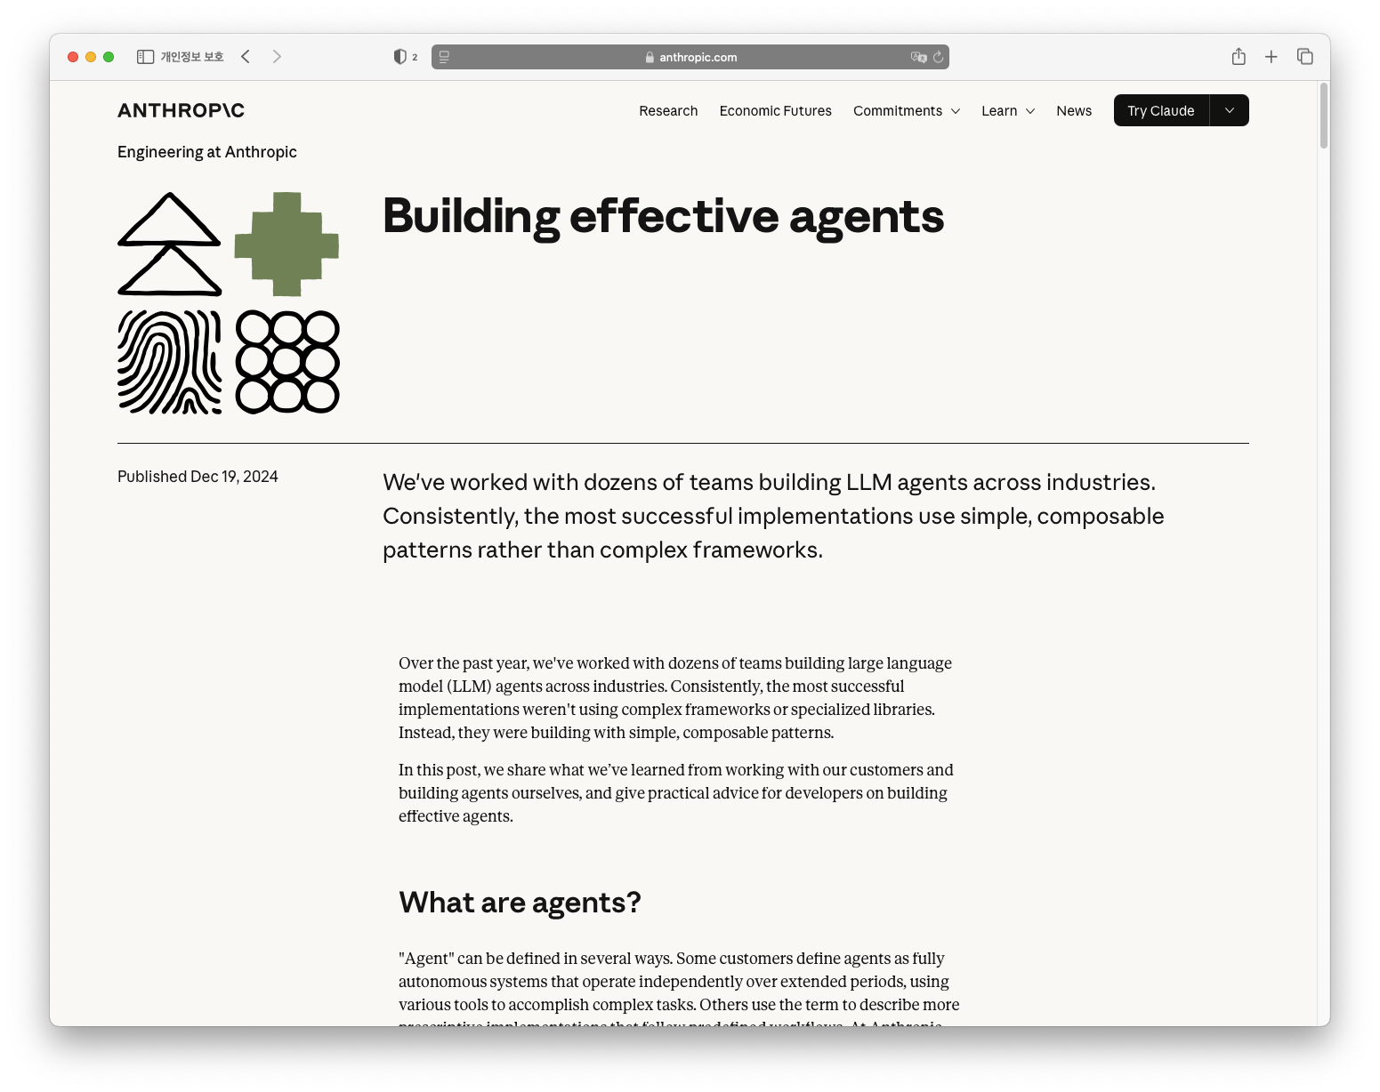
Anthropic: “Start simple. Use direct API calls first”
Introduction
Suggested Approach
Begin with basic loops or scripts
Use raw outputs (JSON / tool responses) directly) Avoid unnecessary abstraction early on
Measure what actually hurts
Only then consider a framework
Core idea:
Simple first, complexity layer
Frameworks are optional, not a prerequisite
Sources: https://www.anthropic.com/engineering/building-effective-agents

Slide 6
Anthropic: “Start simple. Use direct API calls first”
“Over the past year, we've worked with dozens of teams building large language model (LLM) agents across industries. Consistently, the most successful implementations weren't using complex frameworks or specialized libraries. Instead, they were building with simple, composable patterns.”
...
“We suggest that developers start by using LLM APIs directly: many patterns can be implemented in a few lines of code. If you do use a framework, ensure you understand the underlying code. Incorrect assumptions about what's under the hood are a common source of customer error.”
Sources: https://www.anthropic.com/engineering/building-effective-agents

Slide 7
Other voices: Karpathy, Hamel, …
Reference 추가
Andrej Karpathy
“LLM apps = prompt + loop + tools”
Prefer transparent, debuggable code early on
Hamel Husain & Others
Ship v0 with minimal orchestration
Focus on logging, prompts, evals > fancy graphs
Shared message:
Don’t start with heavy abstractions
Own the control flow yourself first
Add frameworks only when pain is proven

Slide 8
Framework? Just use raw Python conde…
Common anti-abstraction claims
“Why use LangGraph? Just write a few lines of Python on top of the LLM API.”
“More abstraction → less control”
“We’ll get locked into the framework”
These concerns are reasonable
Let’s apply the same logic somewhere else…

Slide 9

Why we don’t hand-roll LLM serving?
We use vLLM not because we’re incapable
We use it because we can’t spend all our time on:
KV cache, batching, scheduling
Glud code for every new open-source model
Model rollout / rollback
Monitoring, logging, autoscaling
We delegate infra complexity to a serving framework
This let us focus on:
“What should we serve to users?”
Not “How do we reinvent a serving stack?”

Slide 10
Same logics can apply to Agent Framework
Agent systems have their own “infra”:
Multi-agent orchestration
State management & checkpoints
Retry, pause/resume
HITL, tool calling, long-running workflows
Observability, debugging, testing, deployment
Saying “we’ll code all of this from scratch” is like saying:
“Don’t use vLLM, build your entire serving stack yourself.”
Where do we want to spend our limited engineering time?
Frameworks don’t remove control
They let us delegate low-leverage complexity so we can focus on product & value

Slide 11
Small Teams: Not Desperate, Strategic
👤 Common narrative:
“We’re a small team, we have no choice but to use frameworks.”
📍 My claim:
Small teams are not making desperate choices
They are making strategic choices
Key questions:
With limited people & time
Where do we intentionally invest our engineering effort?
What do we consciously delegate to a framework?

Slide 12
d
그림 그리는 중

Slide 13
The stack of Doom for Small Agent Teams ☠️
Prompt & Agent Design
Per-agent / per-model prompt tuning
System prompts, roles, tools schema
Workflow & Orchestration
Complex branching logic
State management across steps
Error handling & retries
RAG & Data Layer
Vector DB / indices
Retrieval quality, ranking
Data refresh & governance
Tooling & Integration
MCP servers / tool APIs
Internal microservices as tools
Auth, rate limits, quotas
Ops & Platform
Deployment, CI/CD
Monitoring, logging, tracing
Cost & quota management

Slide 14
3-4 Engineers, 3 Months: What’s Realistic?
Small-team reality check 🧮
Team size: 3-4 engineers
TImeline: ~3 months to MVP/launch
Key questions:
Can we implement the entire Stack of Doom in raw Python?
Can we reliably maintain it as requirements & models change?
Can we handle prod incidents, regressions, and feature requests on top?
Strategic view:
Using frameworks is not a sign of weakness
Concentrating effort on differentiating layers
Delegating generic plumbing to a runtime/framework → With this in mind, let’s see where LangGraph fits into this stack.

Slide 15
Why we chose LangGraph (Not settled for it)
Strategic lens for LangGraph
1️⃣ Business - Focus on what the agent does
2️⃣ Financial - Custom agents can be cheaper
3️⃣ Ops - Agents must be safe and resilient
Not “we’re small, we have no choice”
But: “Given our constraints, what’s the smartest stack?”

Slide 16
Business First: What should the agent actually do?
Business-first mindset 💼
Less: “How do we implement multi-agent orchestration?”
More: “what exact workflow should this agent execute?”
With LangGraph, we could spend more time on
Task decomposition & domain logic
UX of failure / clarification / handoff
Guardrails aligned with business rules
The framework handled
Wiring between nodes
State passing, retries, branching → We optimized for user value, not graph plumbing

Slide 17
Costs Matter: When custom agents are actually cheaper
General-purpose agents are convenient… but 💸
Claude Code, generic “do-everything” agents
Great DX, but:
Longer reasoning chains
Morel tool calls & loops
Unpredictable token usage
Custom agent on LangGraph:
Narrow, task-specific flows
Hard limits on: depth of reasoning, number of tool invocations
Predictable + lower per-run cost
Trade off:
Higher dev cost upfront, but Lower operational cost at scale → For us, custom agents were the cheaper choice over time

Slide 18
Ops view: Agents that don’t die or go rogue
Ops reality: shipping =! done 🚨
Real work starts after deployment
We care about
Not just “does it run?”
BUt “does it recover?” and “does it avoid bad actions?”
Operational needs for agents
State & checkpointing
Automatic retries & backoff
Pause / resume long-running workflows
Safe rollbacks on failures
LangGraph gave us A runtime build around these features and hooks for observability
→ This made “don’t die, don’t go rogue” a design property, not an afterthought

Slide 19
Recap: LangGraph as a Strategic Bet
Using an agent framework like LangGraph is
We want to optimize across…
Business - focus on behavior & value
Finance - control run-time cost with custom flows
Ops - build agents that don’t die or go rogue
Lang Graph act as a
Controlled runtime for multi-agent workflows
Platform for survivability features (state, retries, HITL)
→ A strategic decision balancing product, cost, and reliability

Slide 20
Designing “Hard to Kill” multi-agent with LangGraph
This talk is not
A LangGraph 101 tutorial
A feature-by-feature walkthrough
This talk is
A field report on designing resilient multi-agent systems
On top of LangGraph, in real production environments

Slide 21
랭그래프 1.0 릴리즈 캡처

Slide 22
LangGraph 1.0: Perfect Timing
Timing ⏲️
While mapping our “Stack of Doom”
LangGraph 1.0 was officially released
This raised a key question:
“Is this still a demo tool?”
Or “is this ready for production?”

Slide 23
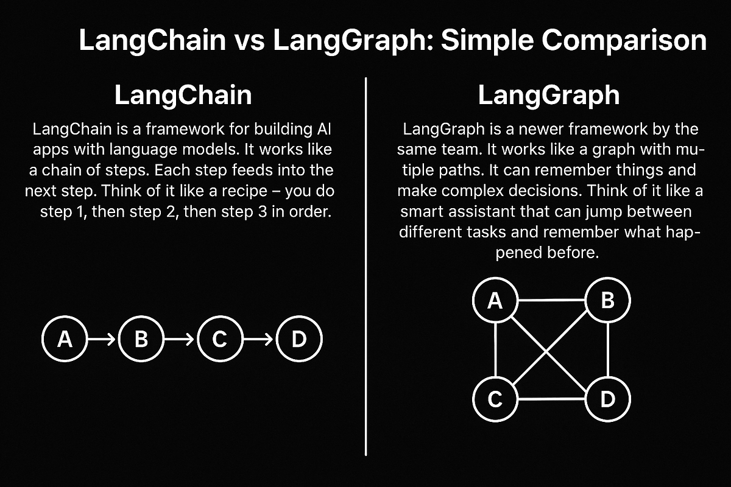
LangChain vs LangGraph: Who does What?
Use LangChain to shape the agent, Use LangGraph to keep the agent alive
Framework | Details
LangChain | Linear flow Built on top of LangGraph Standard agent patterns Tool calling & model wrappers Great for: “build something quickly”
LangGraph | Graph-based flow State-based graph runtime Long-running workflows Checkpoints, interrupt/resume Multi/hierarchical agent orchestration
Sources: https://medium.com/data-science-collective/langchain-vs-langgraph-simple-comparison-9798d8c8a95c

Slide 24
LangGraph 1.0: From Toy to Real Runtime
v1.0 felt like a phase shift
From: “Cool research / demo tool”
To: “Potential production runtime”
Why it mattered to us
Stability for long-running workflows
Durable (parallel) execution + checkpointing
Practical interrupt / resume
Tight integration with LangChain & LangSmith + other Lang-ecosystem
“Can we run production on this?”

Slide 25
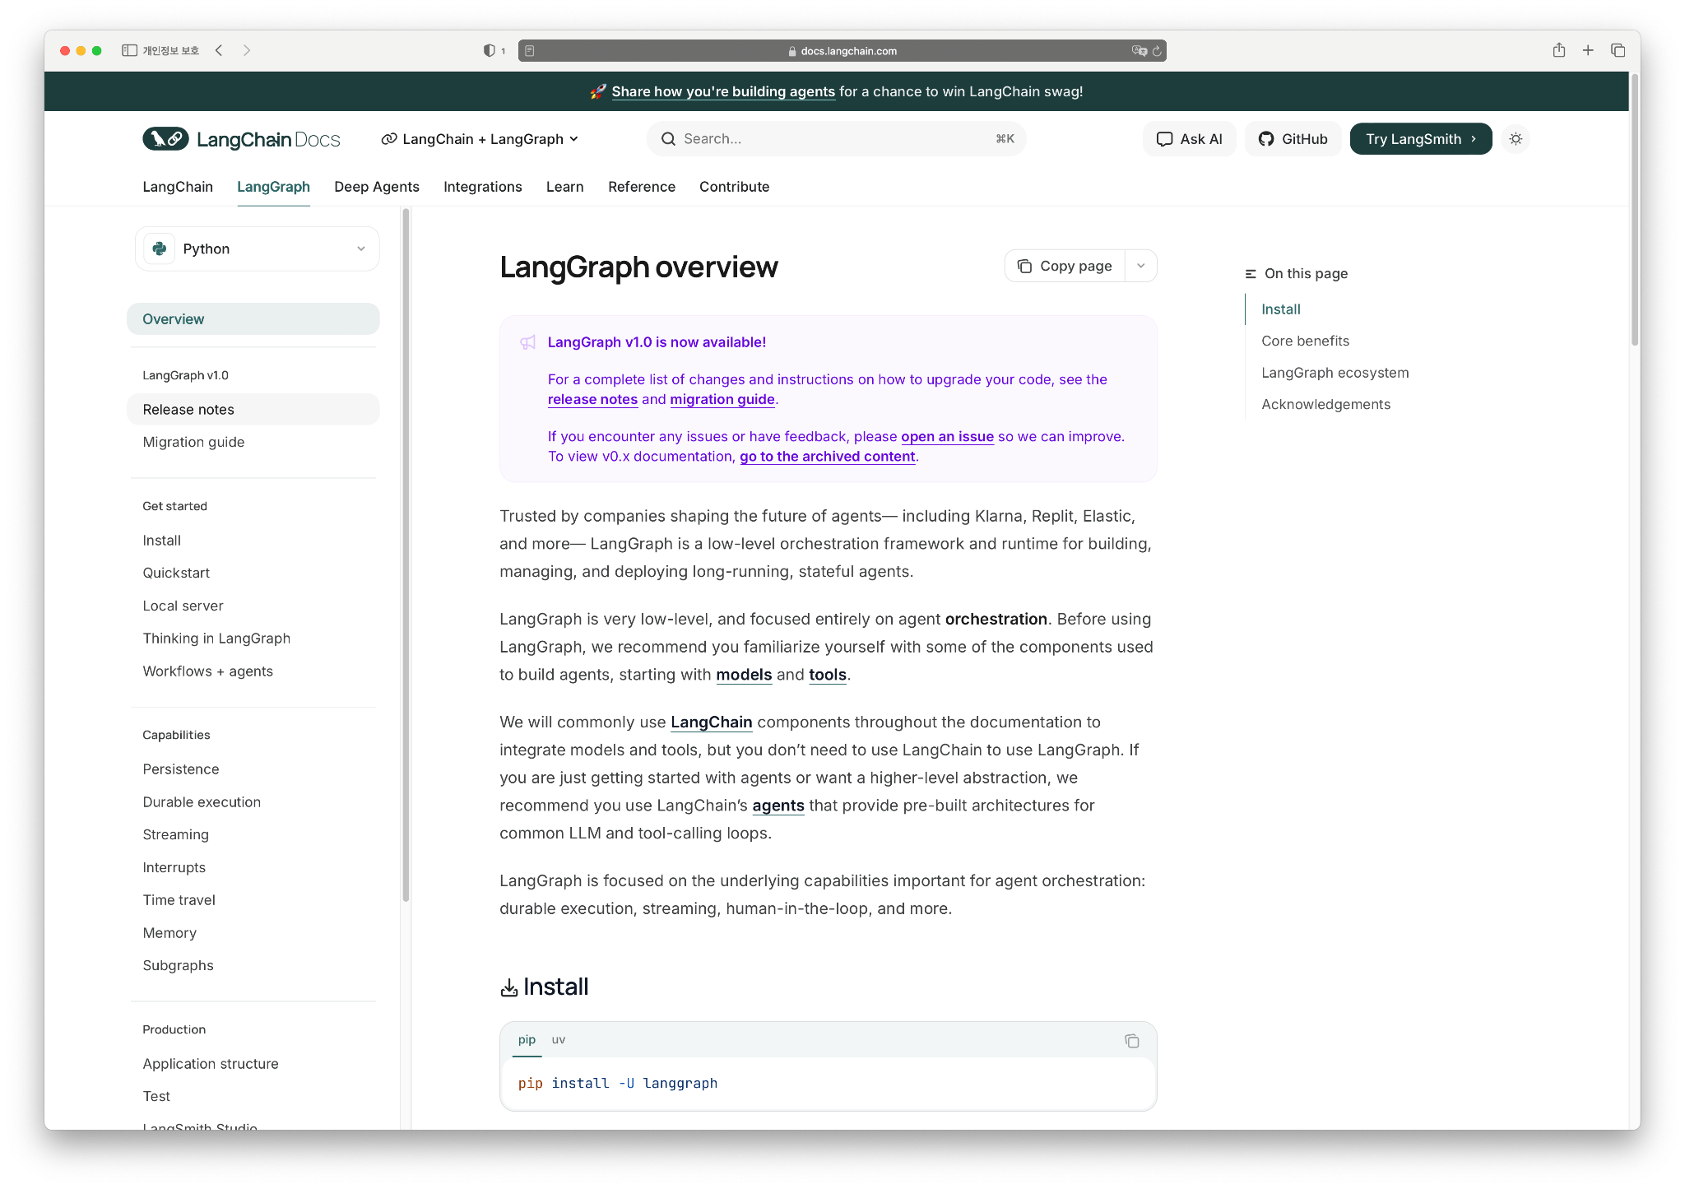
What changed in 1.0
Sources: https://docs.langchain.com/oss/python/langgraph/overview

Slide 26
What changed in 1.0 (That we actually care about)
Key aspects we cared about in 1.0 ✅
Long-running workflow stability
Durable execution & checkpoints
Interrupt / resume at practical level
Full integration with 🦜⛓️LangChain Runnables
🪢 Langfuse integration (+ LangSmith) for observability
Self-hosted agent deployment
More “real orchestration engine for prod”

Slide 27
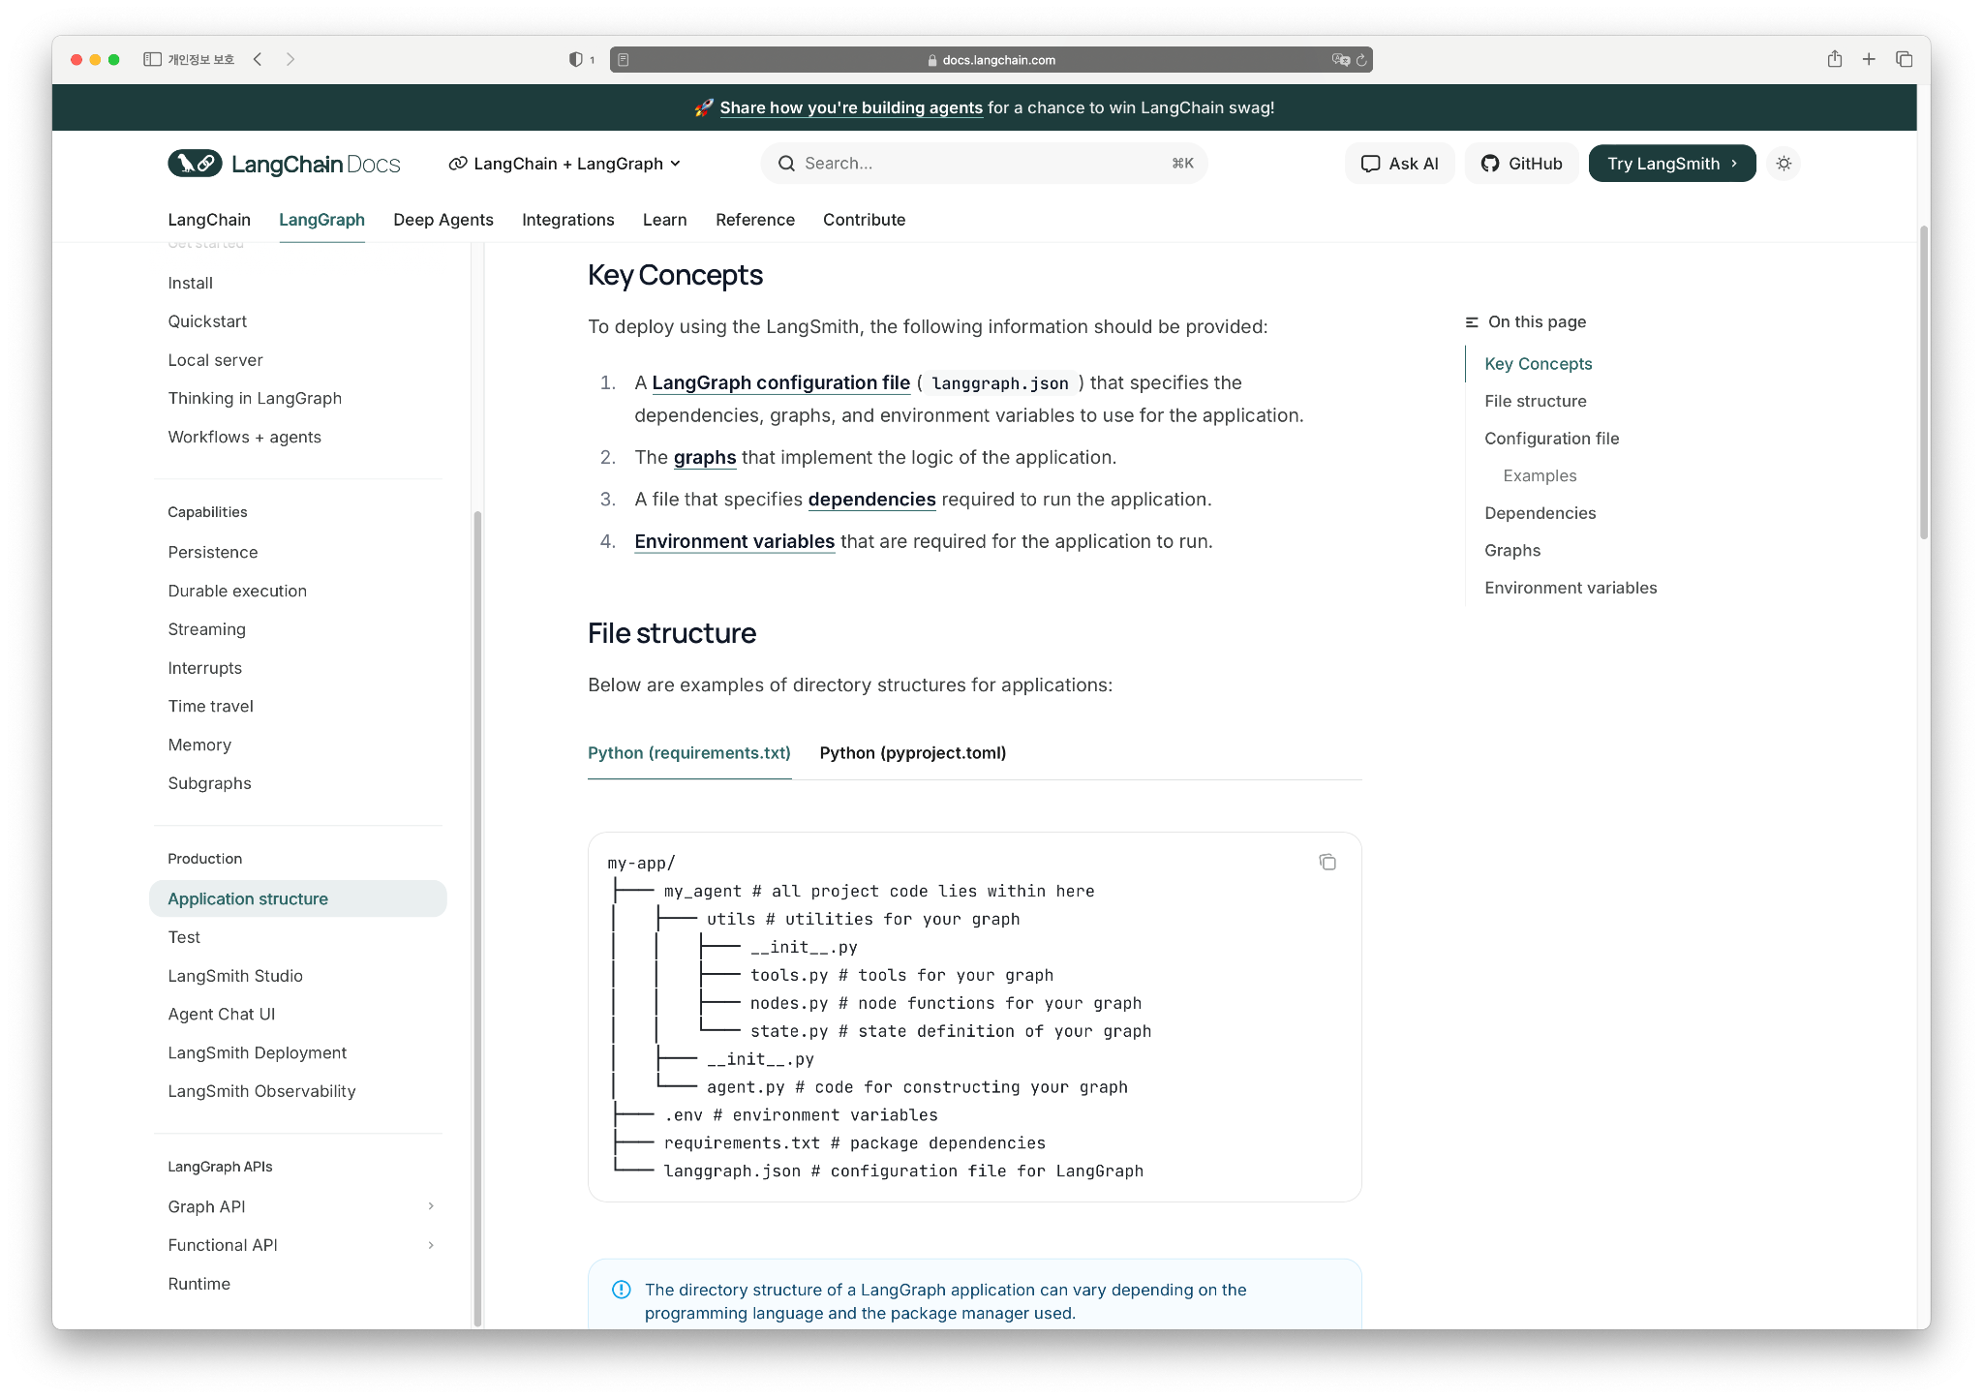
LangGraph Application Structure
📌
Sources: https://docs.langchain.com/oss/python/langgraph/overview

Slide 28
간지

Slide 29
Revisited multi-agent system stack

Slide 30
① LLMs - multiple sources by design
Cloud providers, or LLM Providers
Azure + OpenAI
AWS Bedrock + Claude
GCP Vertexai + Gemini
On-prem OSS serving
E.g., gpt-oss-120b, Qwen3, …
Local / fine-tuned models
Task-specific fine-tuned small LLMs
Assumption: Agents will route across heterogeneous LLM backends

Slide 31
The real issue behind multi-model strategy
Our LLM question was not:
“How can we use many models?”
Our real question was:
“How do we make sure the system doesn’t die when one model dies?”
“How can we shift the model for the recent model without any workflow code changes?”
Multi-model reality:
Azure OpenAI, AWS Bedrock, GCP Gemini
On-prem OSS
Local fine-tuned LLMs
Goal: Swap / fail models without taking the graph down

Slide 32
Why we didn’t hand-code every provider?
Why not implement per-model logic?
Different SDKs
Different parameters
Different error types
→ Managing all of this per-agent = 💀
Approach
Wrap everything behind LangChain’s `BaseChatModel`
Serve OSS via vLLM OpenAI-compatible API
→ Swapping models = config change, not code surgery

Slide 33
In Code: Unifying Models with `BaseChatModel`
<1.0 코드 방식
1.0에서의 불러오는 방식 각각 코드로 보여주기

Slide 34
Keeping the graph alive with `.with_fallbacks()`
Principle
Never expose raw provider errors to the user
Always return some controlled response
Fallback chain example
Primary: Azure OpenAI
→ on failure
Fallback1: AWS Bedrock Claude
→ on failure
Fallback2: GPT=OSS via vLLM
→ on failure
Final: safe “service unavailable” message

Slide 35
Coding the Fallback Chain, Not Try-Except Hell
LangGraph nodes stay simple; the resilience lives in the model layer
With_fallbacks 예시 코드

Slide 36
② Context - everything around the LLM
Tools
Weather, exchange rates, calculator, …
Custom internal tools
Databases
Vector DBs for retrieval / RAG
Legacy DMBS for transactional data
External APIs
Third-party services
Partner/internal microservices
In LangGraph: Nodes = “when/how to call which tool with which state”

Slide 37
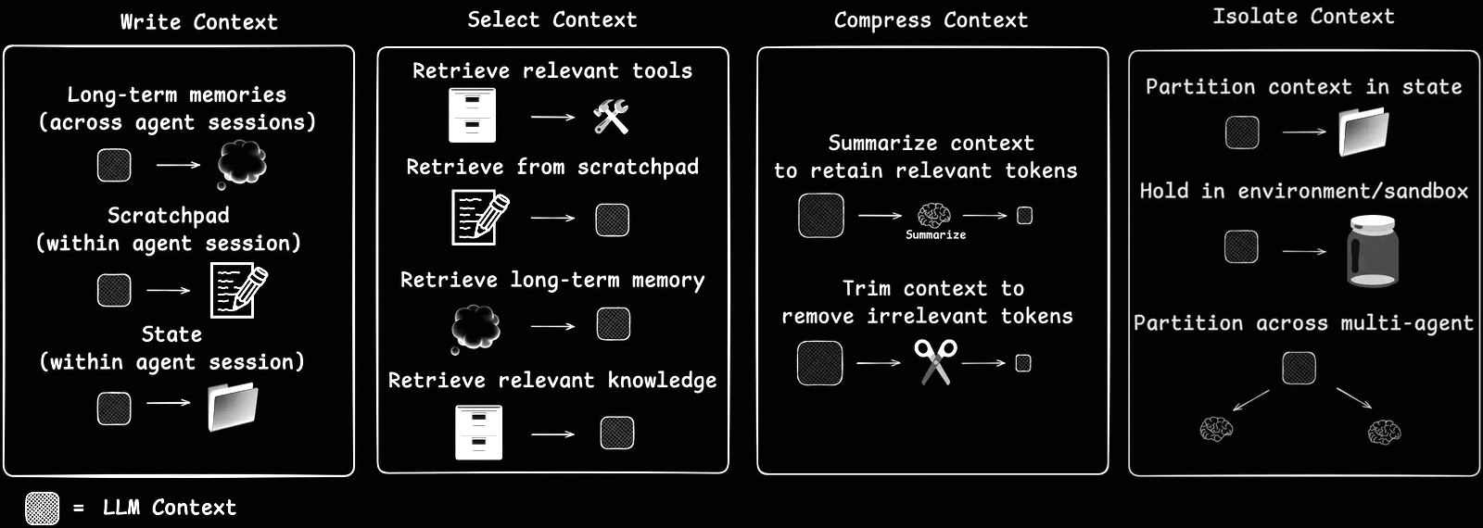
Context Engineering: Feeding LLMs the Right Context
Agents need carefully chosen context to act effectively.
Sources: https://blog.langchain.com/context-engineering-for-agents/

Slide 38
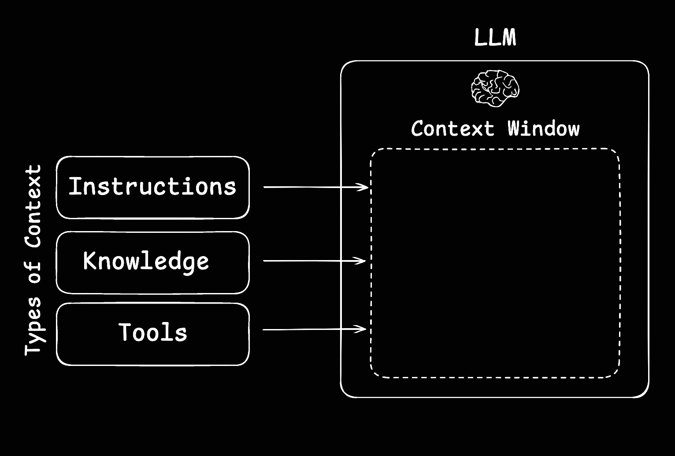
Context Engineering: Feeding LLMs the Right Context
Context engineering is the art and science of filling an LLM’s limited context window with just the right information at each step.
Sources: https://blog.langchain.com/context-engineering-for-agents/

Slide 39
Context as the Agent’s shield
Context = not just “extra prompt text”
It’s a defensive layer for agent survival
Pre-context layer: Clean & sanitize input before LLM
Execution context layer: Keep model/tool calls from exploding
Post-context layer: Validate & adapt output for the product
We focus mostly on the pre-context layer

Slide 40
3-Layer Context Middleware (Pre / Exec / Post)
Layer | Operation
Pre-context layer (before LLM) | Input cleaning & normalization Length control (summaries / trims) PII removal Intent classification / safety filter Context shaping (decide if RAG is needed)
Execution context layer (during calls) | Limit model call count LImit tool calls & recursion Timeouts / circuit breakers Fallback model routing HITL intercepts
Post-context layer (after LLM) | Output normalization Safety filtering Quality threshold → redirect / degrade Summarized or downgraded responses

Slide 41
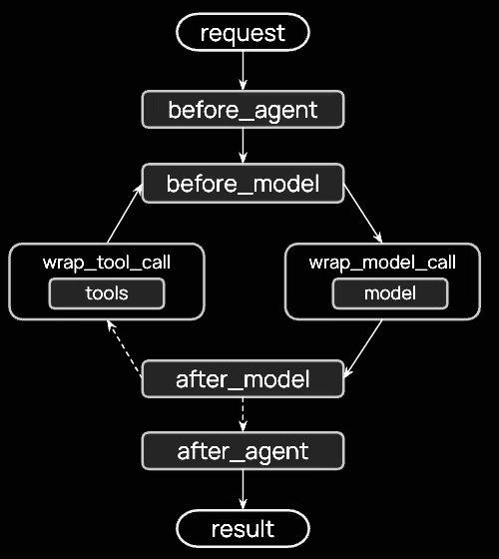
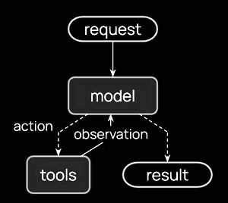
LangChain’s Agent Loop
Middleware provides to handle pre, exec, post context layers seamlessly
Sources: https://docs.langchain.com/oss/python/langchain/middleware/overview#the-agent-loop

Slide 42
Pre-Context I: Shrink the input, Save the run
Problem
Long chat history + raw tool/DB dumps → token explosion
Context length errors and failed runs
Strategy in LangGraph
Use `pre_model_hook` (now middleware in 1.0)
Insert summary / trim nodes before LLM calls
Preserve the minimal context needed for the current decision
Token limit errors are handled at the system level, not left to chance

Slide 43
Pre-Context I: Shrink the input, Save the run
Problem
Long chat history + raw tool/DB dumps → token explosion
Context length errors and failed runs
Strategy in LangGraph
Use `pre_model_hook` (now middleware in 1.0)
Insert summary / trim nodes before LLM calls
Preserve the minimal context needed for the current decision
Token limit errors are handled at the system level, not left to chance

Slide 44
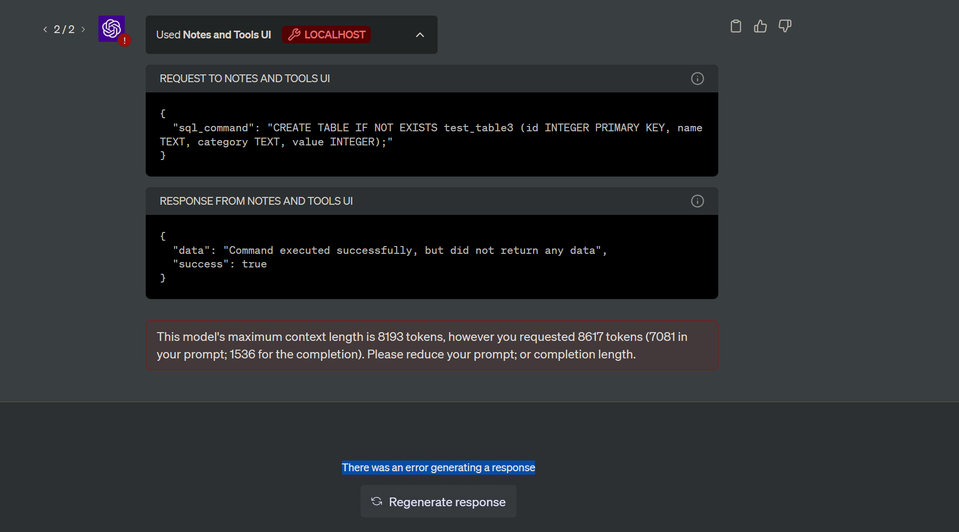
Pre-Context I: Shrink the input, Save the run
Sources: https://community.openai.com/t/this-models-maximum-context-length-is-8193-tokens-does-not-make-sense/288627

Slide 45

Pre-Context I: Shrink the input, Save the run

Slide 46
Pre-Context I: Shrink the input, Save the run
예시 코드

Slide 47
Pre-Context II: Mask PII at the door, Not after the fact
PII examples
Phone numbers, credit card numbers
Email addresses, national IDs
Design choice
Strip / mask PII before LLM sees anything
Implement as a dedicated PII-masking node at the graph entry
This is about security & compliance, not prompts
Post-incident, we can confidently say: “No raw PII ever entered the LLM context”

Slide 48
Pre-Context II: Mask PII at the door, Not after the fact
In practice
Regex + validators in a LangGraph node
Replace with place holders (<|PHONE|>, <|CARD|>, …)
Optional mapping table stored on a secure side-channel if needed

Slide 49
Pre-Context II: Mask PII at the door, Not after the fact
In practice
Regex + validators in a LangGraph node
Replace with place holders (<|PHONE|>, <|CARD|>, …)
Optional mapping table stored on a secure side-channel if needed
위에 대한 예시 코드

Slide 50
Pre-Context III: RAG only when needed
Native RAG pattern
Query → retrieve docs → send all docs + query to LLM
Problems in production
Unnecessary retrieval cost for simple queries
Irrelevant docs polluting the prompt
Higher latency & token usage
Context shaping layer
Pre-LLM router decides: direct LLM vs RAG, which domain retriever to use, how many docs
Based on query type, intent, and risk

Slide 51
③ Workflow - where LangGraph shines
Prompts
System / task prompts per agent
Source code
Routing logic, transformations, validation, …
State
Conversation state, intermediate results
Authorization / policies
Who can trigger what, with which tools
This is modeled as a LangGraph:
Nodes = agents / tools / control logic
Edges = transitions based on state & outcomes

Slide 52
How LangGraph keeps agents alive at runtime
Agent-level survival features in LangGraph
Recursion limit → stop infinite loops
Errors as state, not exceptions
Multi-level timeouts
Interrupts / breakpoints
Combined goal: infinite loop and infinite waiting

Slide 53
Recursion Limit: Cutting infinite loops with recursion limits
Common failure mode: infinite loops
Agent A → Agent B → Agent A → …
Misplanned “try again” loops that never end
LangGraph’s help
Pregel-style engine with recursion limit
Stop execution after N graph steps / hops
LLM can still make bad plans
But the runtime prevents bad plans from killing the system

Slide 54
Recursion Limit: Cutting infinite loops with recursion limits
위에 대한 예시 코드

Slide 55
Errors as State, Not Exceptions
Traditional view: Error = throw exception → 500
Our graph view: Error = part of state
State schema example:
status: “ok” | “error” | “degraded”
error: error code / message
attempts: number of retries
Errors are handled inside the graph, instead of killing the entire service

Slide 56
Timeouts: Don’t let one slow node freeze the graph
Multi-level timeouts
Model call timeout
Tool call timeout
Overall graph execution timeout
Per-node timeouts, e.g.
Retrieval + justification node: up to 5s
Simple reformatting node: abort after 2s, then fallback
On timeout
Route to summarized / partial answer node, user-facing apology + background queue node
Users rarely see “I can’t find anything” / “no result” non-answers

Slide 57
Stopping both infinite loops and infinite waiting
Defending against two big enemies:
1️⃣ Infinite loops
2️⃣ Infinite waiting
LangGraph survival combo:
recursion_limit → cap steps / loops
timeouts → cap waiting per node / graph
interrupts → inject humans at critical points
errors-as-state → avoid global 500s
Together, these turn LangGraph from:
“a nice way to draw graphs”
into “a runtime that keeps your multi-agent system alive in production”
작업 필요;?

Slide 58
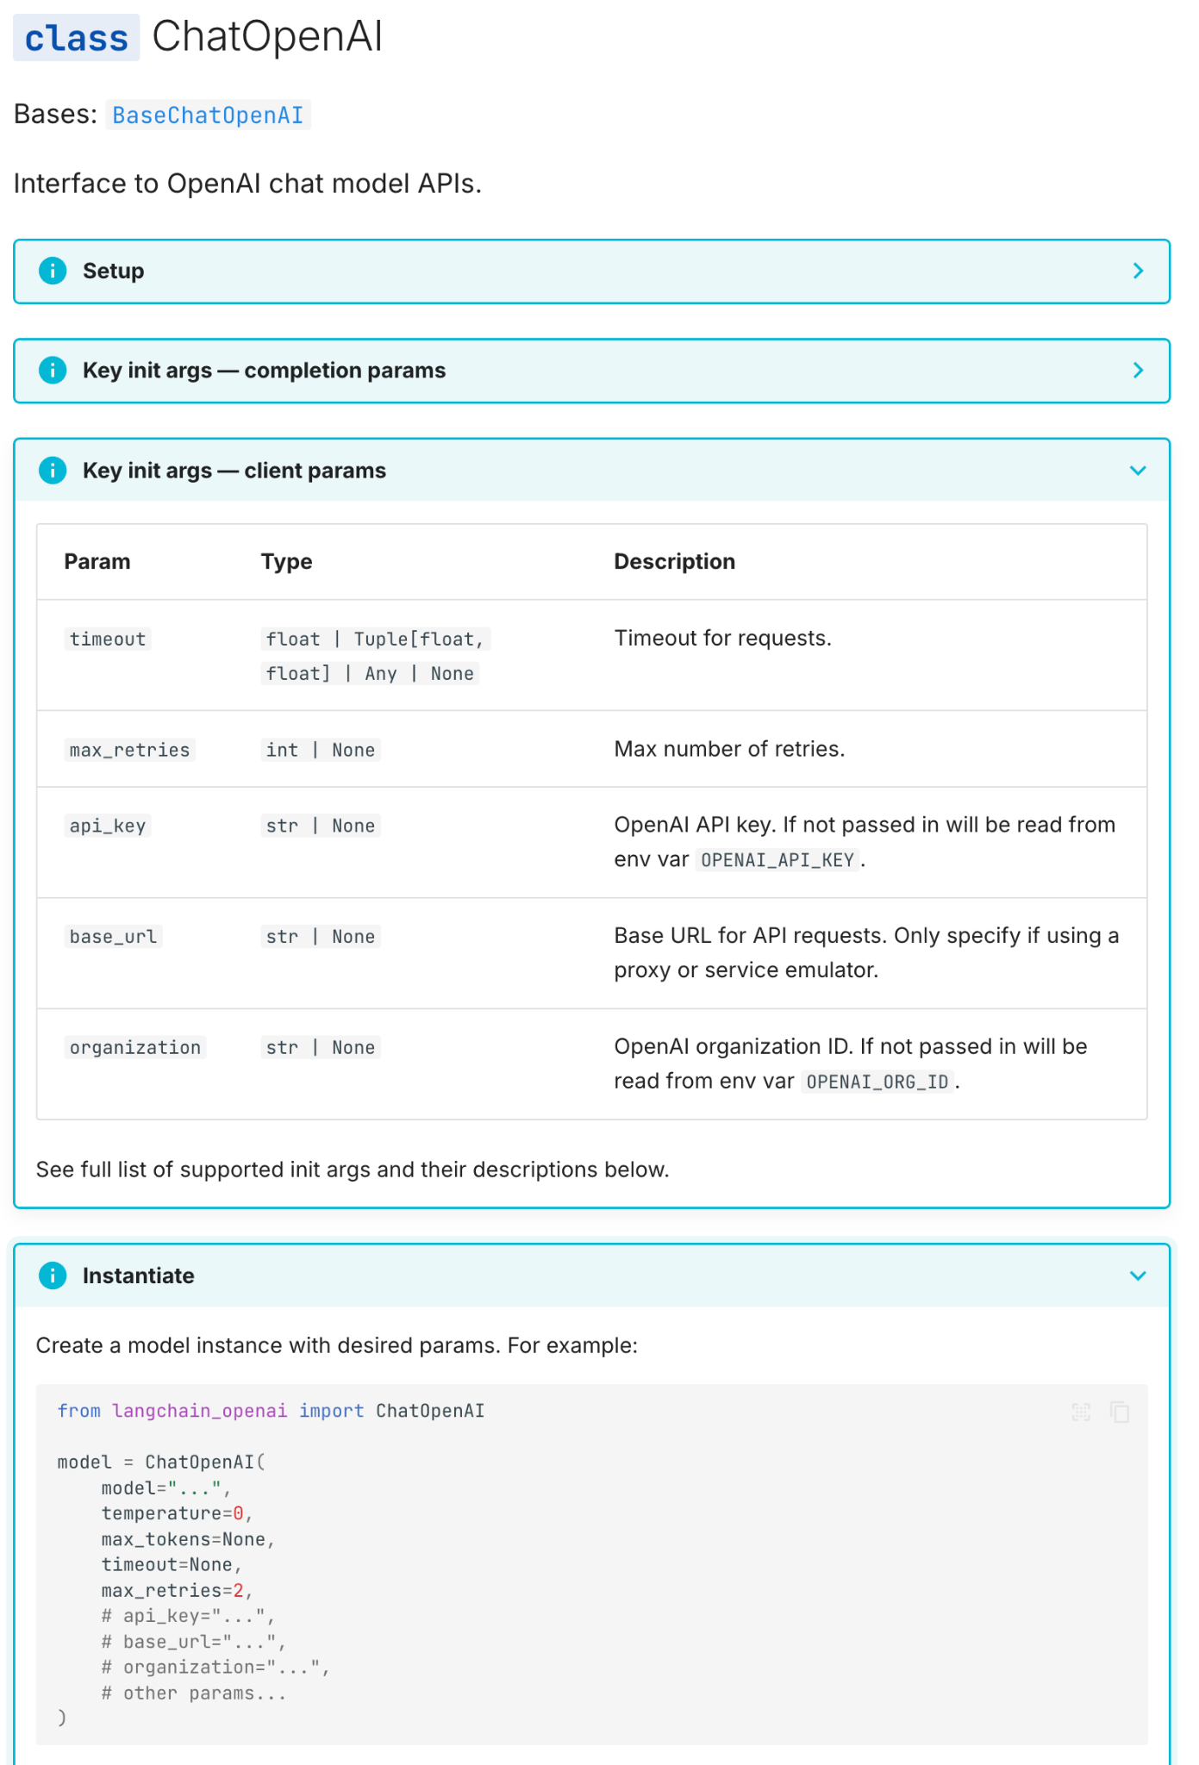
Wait… We were already using safety features
safety feature were used by default
Built-in features
Default retries (max_retries)
Exponential backoff
Fail-safes model calls
…

Slide 59
④ Ops & Assets - keeping agents alive in prod
Ops
Deployment, CI/CD
Monitoring, logging, alerting
Cost & quota control
Assets
Config, secrets
Prompt & model versions
Policy definitions
LangGraph’s role here
Exposes traces, checkpoints, execution logs
Makes the workflow observable by external Ops tooling

Slide 60
Observability: You can’t fix what you can’t see

Slide 62


Limitations of Pandas
Introduction
High memory usage
Performance degradation
Low scalability
Memory mapping issue
Garbage collection
Not thread safe

Slide 63
High Memory Usage
Introduction
Object overhead
Every objects has additional metadata about data type, index and extra.
All python objects are python objects
Data type handling
Data in a more memory intensive way
Indexing

Slide 64
Degraded Performance
Introduction
Single-threaded operations
Python GIL(Global Interpreter Lock) underlies this issue
Inefficient data types
Default backend data type is Numpy , not designed for Pandas DataFrame
Performance dependent to the factors of Numpy
Overhead of python objects
Before operations, type-checking or data correctness cause overhead
Lack of optimization
Unexpected object assignment and copy cause memory overflow
Operations especially allowing inplace parameter show this issue

Slide 65
Low Scalability
Introduction
Designed for single-machine
No built-in distributed computing support
In-memory requirement

Slide 66
Other Issues
Introduction
Pandas memory mapping issue
Not collected garbage
Not thread safe

Slide 67
How to scale & Alternatives to Pandas
Introduction
Buy more RAM…….
Ray, Dask, Modin
Numba, cuDF
Polars

Slide 68
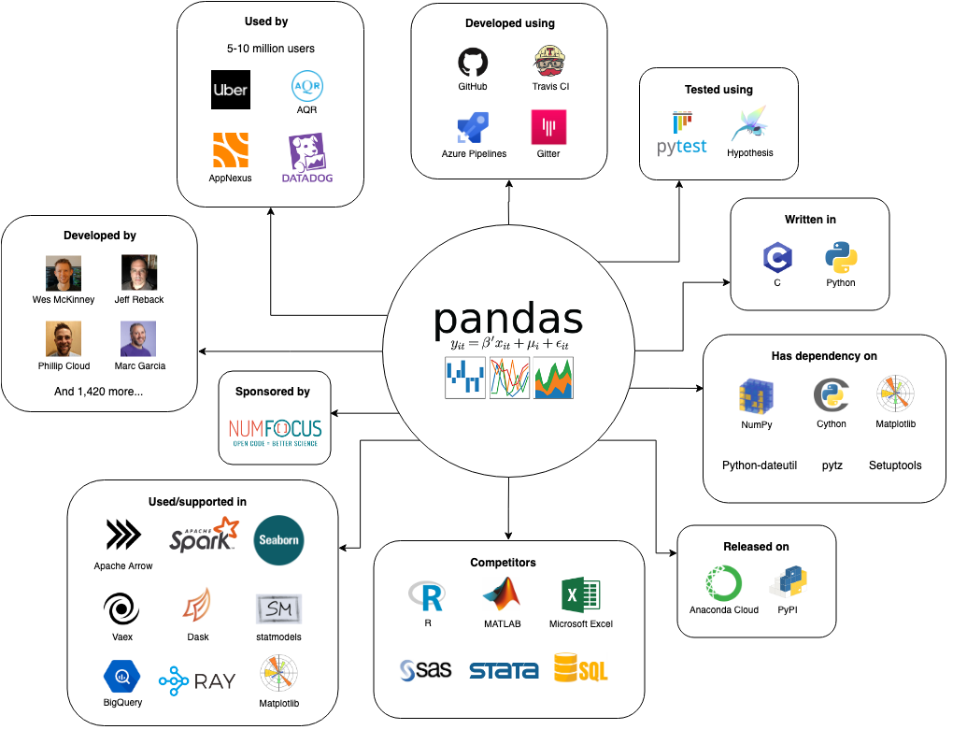
Pandas Ecosystem
Introduction
Sources: https://se.ewi.tudelft.nl/desosa2019/chapters/pandas/

Slide 69
Frequently Asked Questions about Pandas (1)
Introduction
Q: Why does my machine slow down when I try to apply a function across large Pandas DataFrame?
Q: Can pandas handle data streaming for real-time data processing on large datasets?
Q: Why is saving large DataFrame to a CSV file using Pandas so slow?

Slide 70
Frequently Asked Questions about Pandas (2)
Introduction
Q: I tried to replace all the NaN values in large DataFrame using the fillna() function in Pandas and it crashed. How can handle this?
Q: How can I handle very very large dataset even not being saved on local hard disk with Pandas? (ex. over 10 TeraByte or 1 PetaByte)

Slide 71

Pandas 2.0 Released
Timeline of Pandas

Slide 72
2008-2009 Beginning
Timeline of Pandas
Created by Wes McKinney while working at AQR Capital Management in 2008
Motivated from programming R data frame
Designed to handle time-series and structured data in Python
Released initial version as BSD license in January 2009
Received significant contributions from open-source community

Slide 73
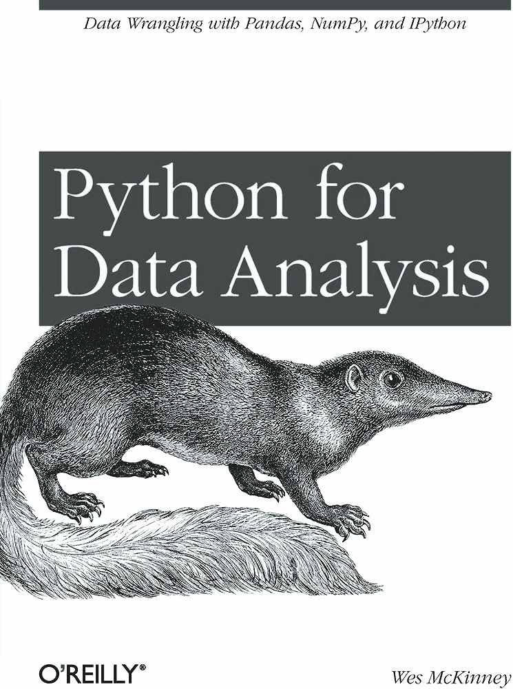
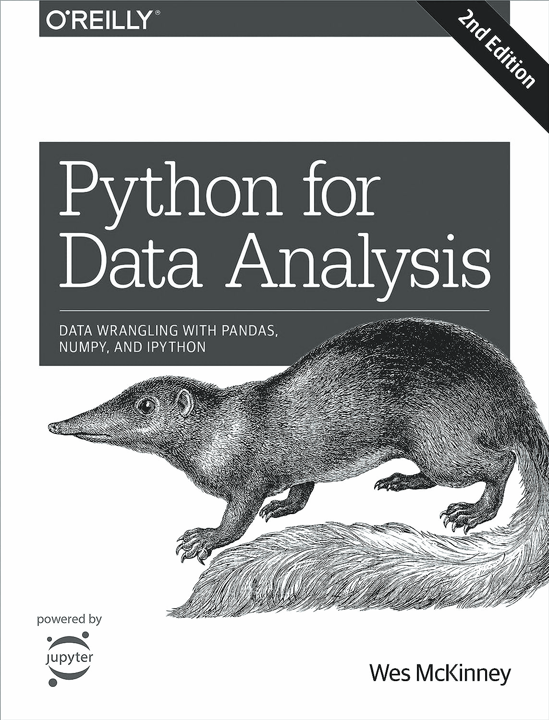
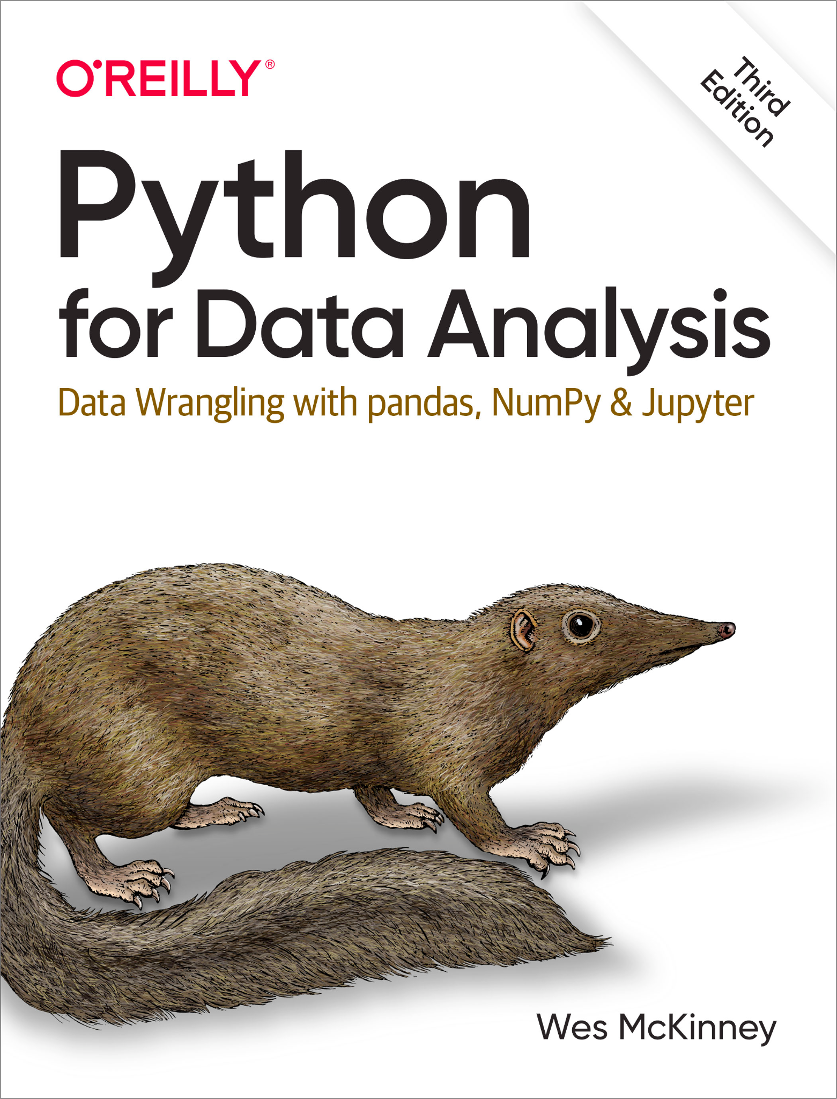
2012 Growth with Book
Timeline of Pandas
Published the book ⌜Python for Data Analysis⌟
Complement to the lack of Pandas documentation
Well-written, easy to understand with a wealth of practical examples and exercises
Sources: www.amazon.com

Slide 74
2013 Integration with Scientific Ecosystem
Timeline of Pandas
Became a core component of the scientific Python ecosystem with other libraries such as NumPy, SciPy, and Matplotlib
Solidified the position with the increased attention on Machine Learning and the library Scikit-learn

Slide 75
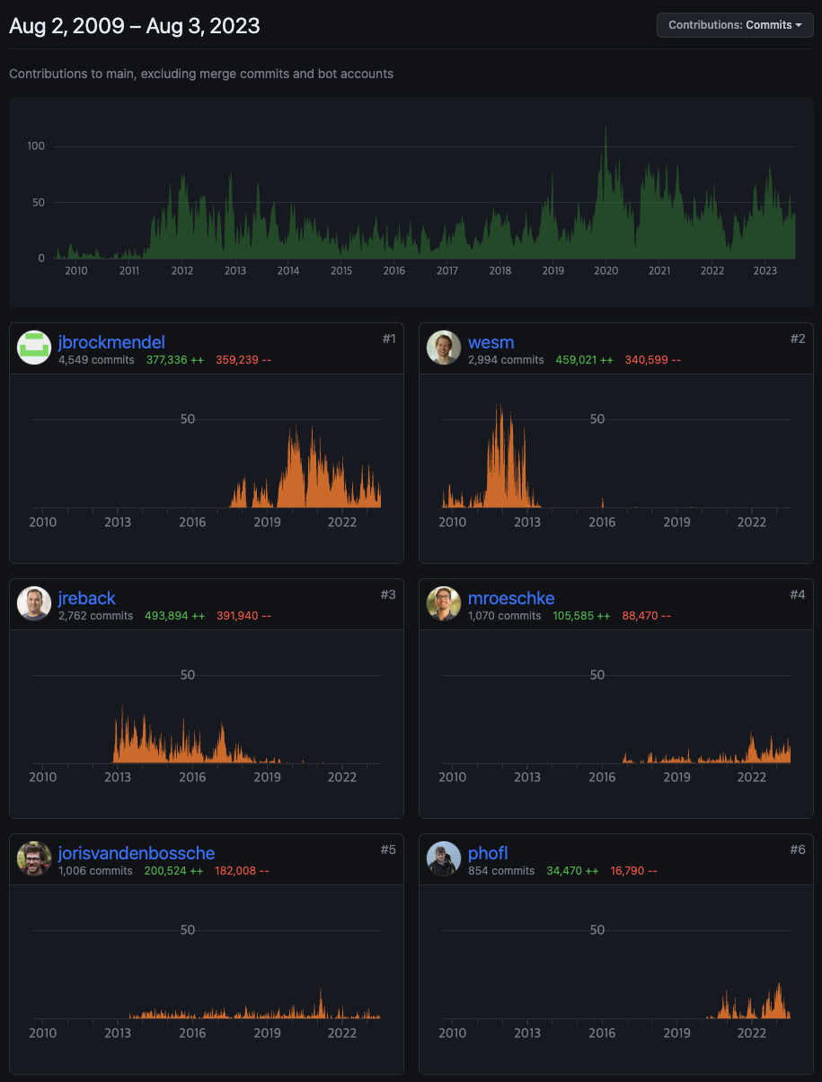
2014 Wes Mckinney Disappear
Timeline of Pandas
2017, Blog “10 Things I Hate About pandas”
2016, GitHub repo. Pandas2
2015, Blog “Joining Forces for an Arrow-Native Future”
Sources: https://github.com/pandas-dev/pandas/graphs/contributors

Slide 76

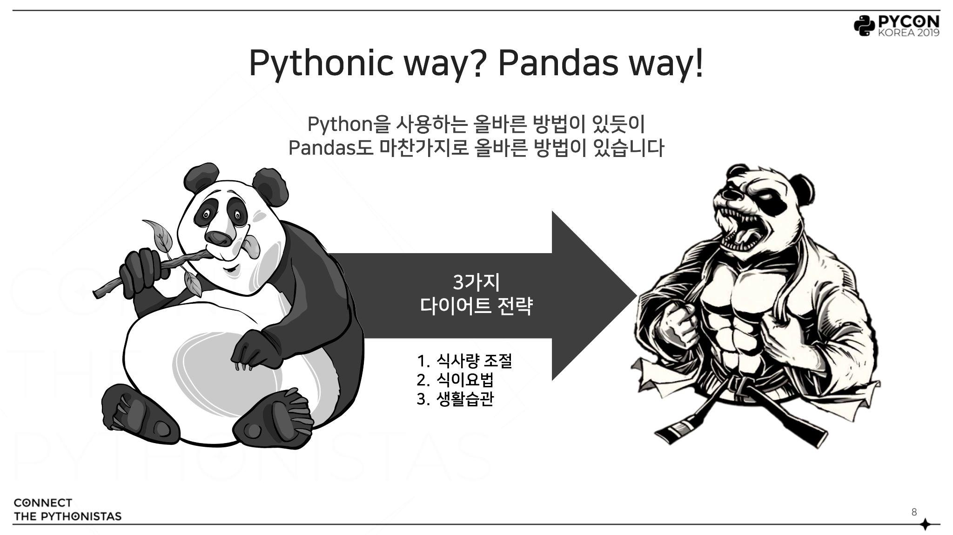
2019 PyCon KR 2019: Session speaking
Timeline of Pandas
Propose three strategies to use Pandas more memory-efficient and performance-enhancing ways

Slide 77
2020 Pandas 1.0 Release
Timeline of Pandas
I remember it was a version deployment with a lot of symbolism
Became influential in the data science field and important to data processing/analysis tools
Widely used in both academia and industry

Slide 78
2023 Pandas 2.0 Release
Timeline of Pandas
Unlike Pandas 1.0, added a lot of performance and functionalities improvement without hurting user experience
Increased integration with Apache Arrow in many features and areas since first integration with Pandas 1.5

Slide 79
What’s New in Pandas 2.0 & Features
What’s New in Pandas 2.0
Enhanced Performance and Memory Efficiency
Improved Support for Time-Series Data
Introduction to Nullable Data Types (ref. upcasting issue)
CoW Improvements
Apache Arrow Integration

Slide 80
CoW Improvement
What’s New in Pandas 2.0
Resource management technique that shares resources but creates new resources only when a copy has been modified, without the need to create new resources
In a single-thread, Copy & Write are performed separately
In a multi-threaded, Copy & Write are performed simultaneously
Example: Storing snapshots of data

Slide 81
Copy-on-Write
What’s New in Pandas 2.0
Physical
Memory
Process1
Process2
Page A
Page B
Page C
Sources: https://www.cs.uic.edu/~jbell/CourseNotes/OperatingSystems/9_VirtualMemory.html

Slide 82
Copy-on-Write
What’s New in Pandas 2.0
Physical
Memory
Process1
Process2
Page A
Page B
Page C
Copy of Page C
Sources: https://www.cs.uic.edu/~jbell/CourseNotes/OperatingSystems/9_VirtualMemory.html

Slide 83
CoW in Pandas 2 & 3
What’s New in Pandas 2.0
The technique mitigates the arbitrary alteration or deletion of resources in Pandas DataFrame
Through integration with PyArrow, it’s expected to become more robust
This is also why the use of Chained Assignment is recommended (+ Python’s more precise error messaging is beneficial)

Slide 84
Official Documentation about CoW in Pandas
What’s New in Pandas 2.0
Introduced in version 1.5.0, Copy-on-Write (CoW) now supports most possible optimizations since version 2.0.
CoW is likely to be default from version 3.0.
By preventing multi-object updates in single statements, CoW provides more predictable results and eliminates side effects like indexing. Furthermore, by delaying copies, it enhances performance and memory usage.
Sources: https://pandas.pydata.org/docs/user_guide/copy_on_write.html

Slide 85
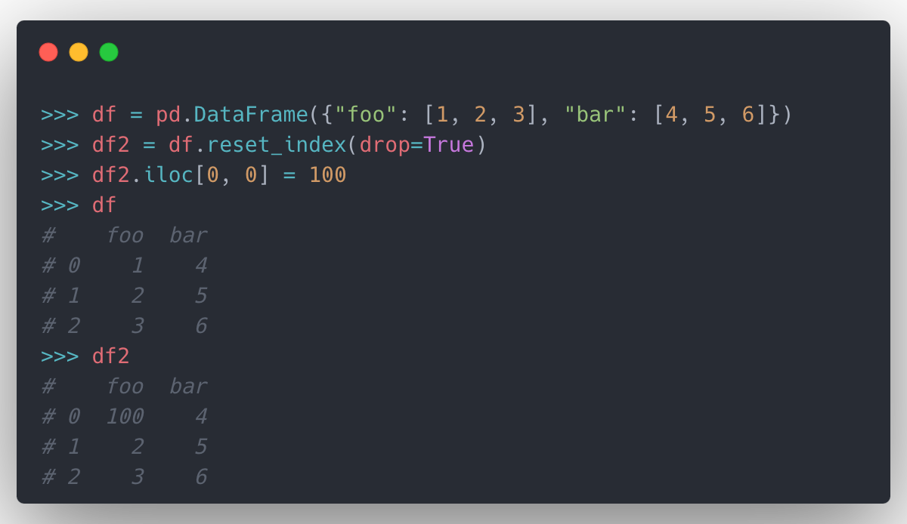
Example of CoW in Pandas
What’s New in Pandas 2.0
Sources: https://pandas.pydata.org/docs/user_guide/copy_on_write.html

Slide 86
PyArrow Functionalities in Pandas 2.0
What’s New in Pandas 2.0
More extensive data types compared to NumPy
Missing data support (NA) for all data types
Performant IO reader integration
Facilitate interoperability with other dataframe libraries based on the Apache Arrow specification (e.g. polars, cuDF)
Sources: https://pandas.pydata.org/docs/user_guide/pyarrow.html

Slide 87

Apache Arrow
What’s New in Pandas 2.0
Cross-language development framework for in-memory data
Language-independent columnar memory format
Organized for efficient analytic operations on CPUs and GPUs
Supports zero-copy reads for lightning-fast data access without serialization overhead
Available for C, C++, C#, Go, Java, JavaScript, Julia, MATLAB, Python, R, Ruby, and Rust
Sources: https://arrow.apache.org

Slide 88
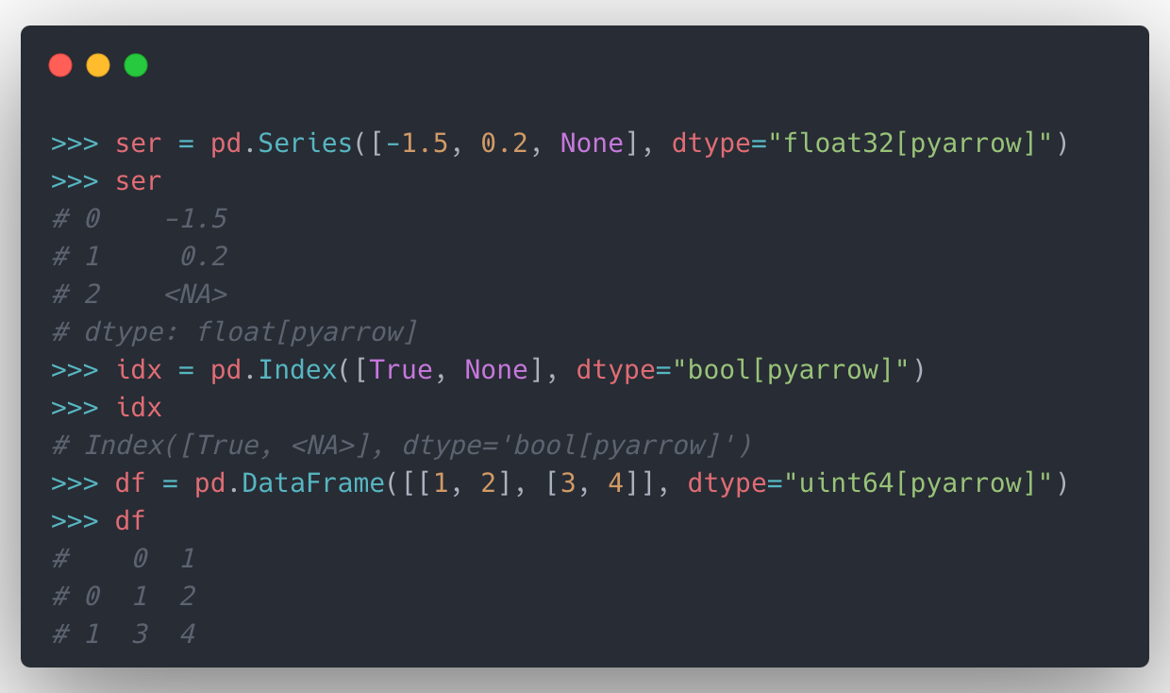
Pandas with PyArrow
What’s New in Pandas 2.0
Enhances memory efficiency and performance
Performs faster computations and Manages larger datasets
Sources: https://pandas.pydata.org/docs/user_guide/pyarrow.html

Slide 89
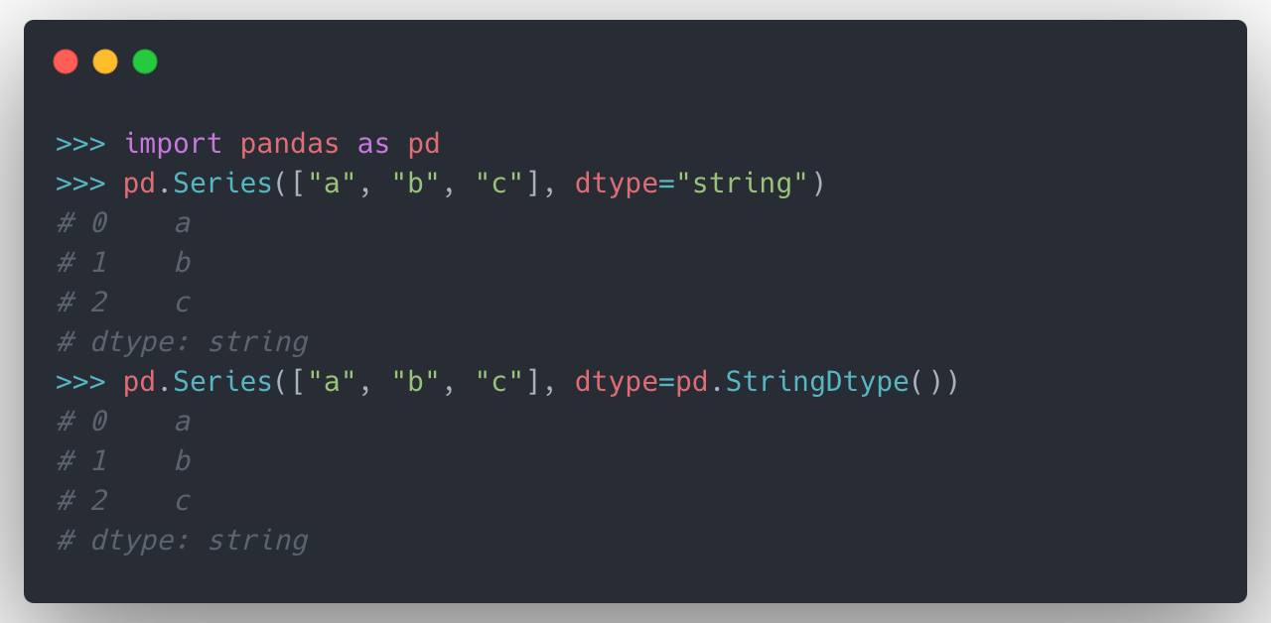
Working with text data in Pandas 2.0
What’s New in Pandas 2.0
Recommended to use string rather than object dtype for text data
Sources: https://pandas.pydata.org/docs/user_guide/text.html

Slide 90
Experiment on Pandas 2.0
What’s New in Pandas 2.0
Experiment by Marc Garcia who is main contributor of Pandas
Operation | Time with NumPy | Time with Arrow | Speed up
read parquet (50Mb) | 141 ms | 87 ms | 1.6x
mean (int64) | 2.03 ms | 1.11 ms | 1.8x
Mean (float64) | 3.56 ms | 1.73 ms | 2.1x
endswith (string) | 471 ms | 14.9 ms | 31.6x
Sources: https://datapythonista.me/blog/pandas-20-and-the-arrow-revolution-part-i

Slide 91
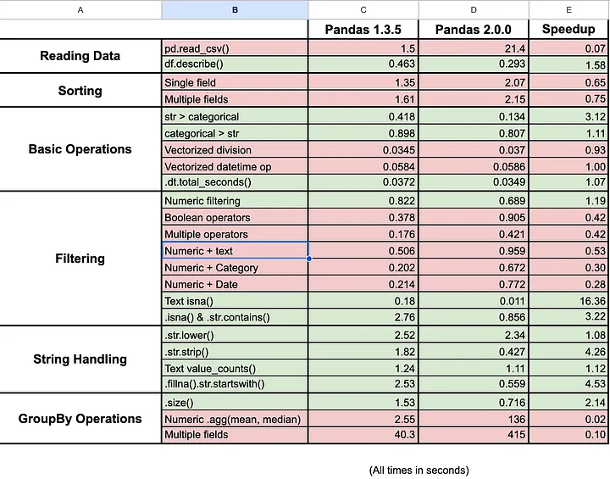
Improved on Text, but on Others?
What’s New in Pandas 2.0
Be cautious to migrate to Pandas 2.0 from legacy
Not all operations and data types are fully supported and integrated with PyArrow
Unexpected Errors might occur
Sources: https://medium.com/@santiagobasulto/pandas-2-0-performance-comparison-3f56b4719f58

Slide 92
Recap of 2019’s Efficient Pandas Strategies [Link]
Validation of 2019’s Efficient Pandas Strategies
전략1. Memory Optimization
건강검진 데이터
1-2 Convert Dtypes
1-1 Coding
1-4 IO File Format
진료내역 데이터
1-3 Category type
전략2. Performance Enhancement
3-1 Method Chaining
3-2 .inplace parameter
3-3 Deprecations
2-1 Vectorization
2-2 Efficient Algorithm
2-3 Beyond apply()
전략3. Adopting Conventions

Slide 93
Reproduction of 2019 Strategies
Validation of 2019’s Efficient Pandas Strategies
Open Data provided by NHIS(국민건강보험공단)
2019 Strategies were tested on Larger dataset
 |  | PyCon KR 2019 | PyCon KR 2023
Health Check Data 건강검진 데이터 | Range | 3y (2015 ~ 2017) | 19y (2002 ~ 2020)
 | Rows | 3 M | 19 M
 | Size | 0.3 GB | 1.9 GB
Medical History Data 진료내역 데이터 | Range | 3y (2015 ~ 2017) | 19y (2002 ~ 2020)
 | Rows | 40 M | 185 M
 | Size | 3.1 GB | 14 GB
Data Source1: https://www.data.go.kr/data/15007115/fileData.do
Data Source2: https://www.data.go.kr/data/15007122/fileData.do

Slide 94
Comparison between Pandas Versions
Validation of 2019’s Efficient Pandas Strategies
PyCon KR 2019 ⇥ Pandas 0.24.2
PyCon KR 2023 ⇥ Pandas 2.0.3, + [pyarrow]
Pandas 0.24.2
Pandas 2.0.3
Pandas 2.0.3 [pyarrow]

Slide 95
I. Memory Optimization
I. Memory Optimization
Purpose
: to read and manipulate large dataset efficiently
Testing
Specifying data types to reduce time and memory usage
Default: read and manipulate with default setting
Codebook: replace string values with fixed-size int dtype using codebook
Dtypes: specify data type for each column when reading a file
Comparison between file formats - csv, pickle, feather, parquet
Time to write/read a file
Disk size of the saved file

Slide 96
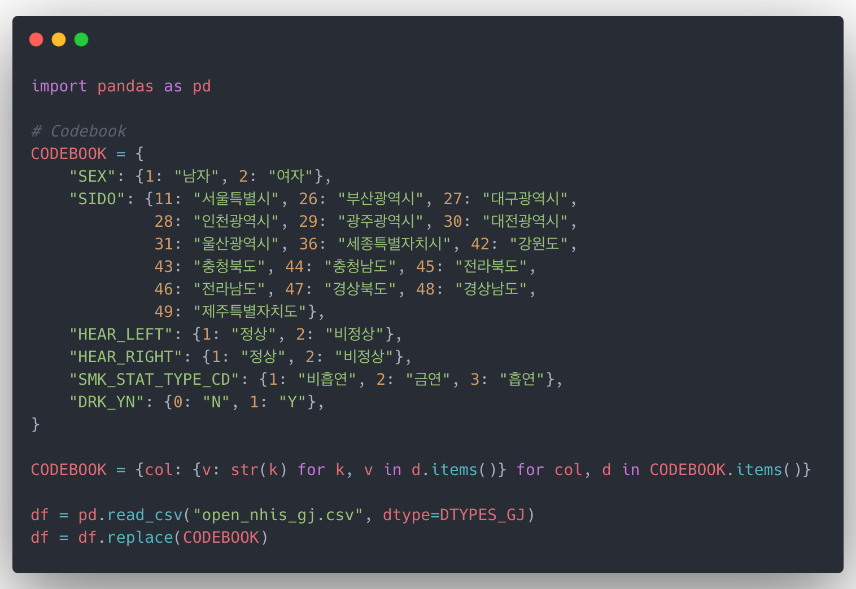
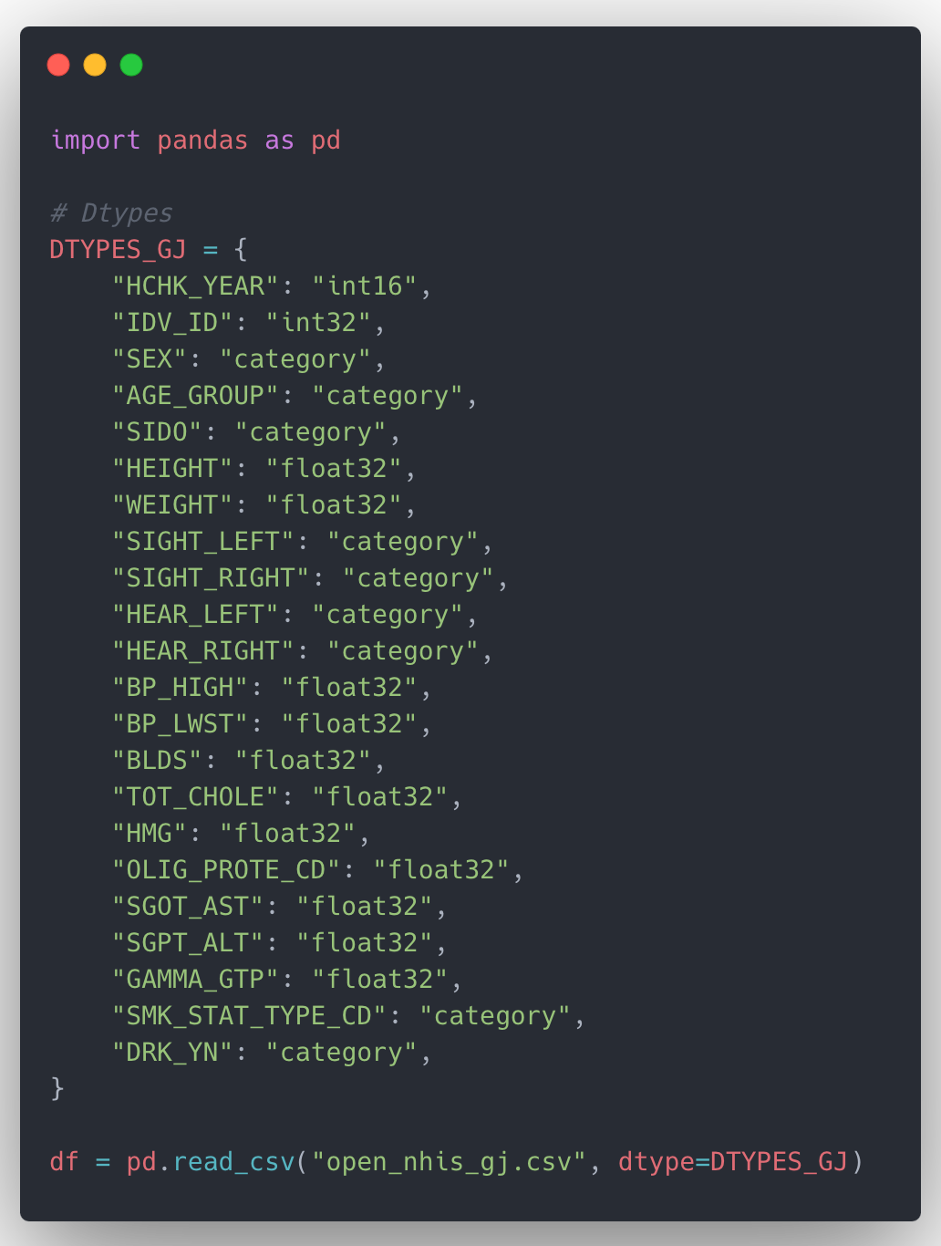
[Appendix] How to specify data types
I. Memory Optimization
Codebook
Dtypes

Slide 97
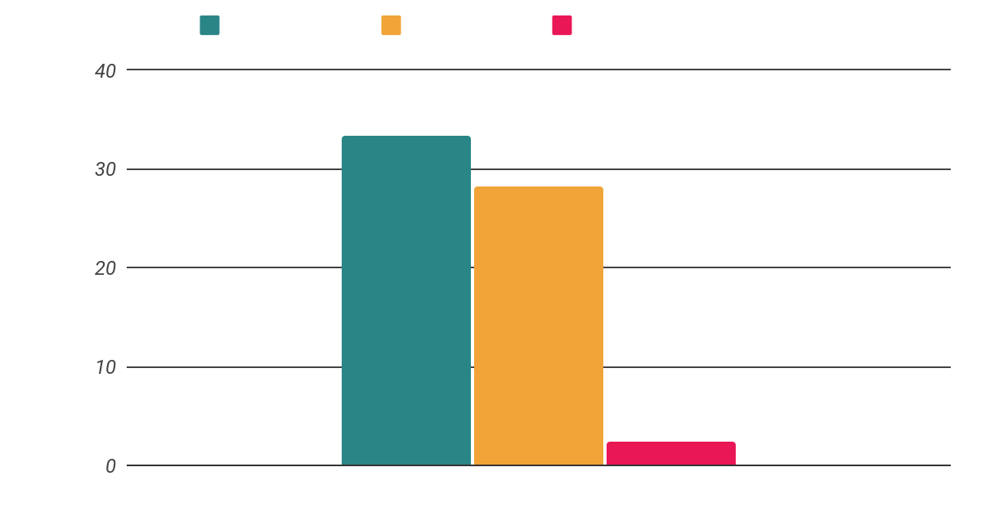
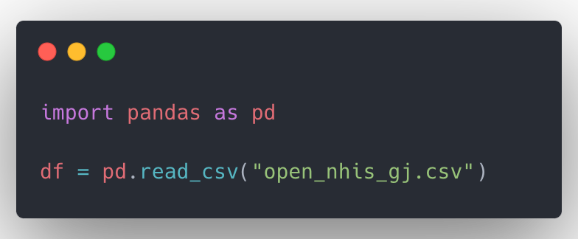
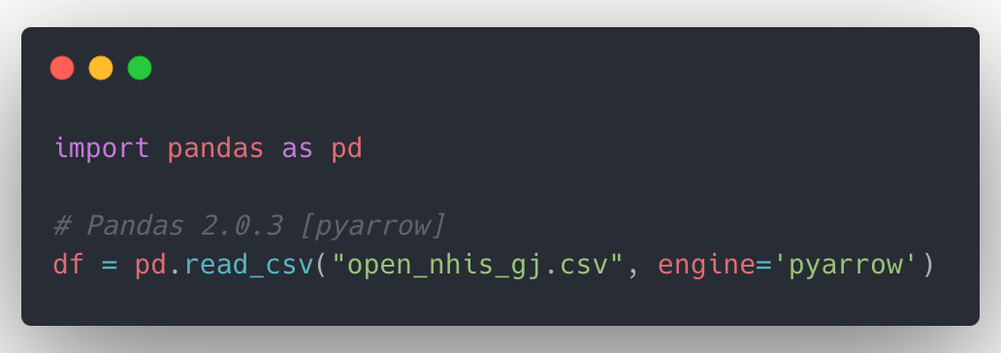
1-1. Time to read a CSV file
I. Memory Optimization
Read a csv file on Default setting

Slide 98
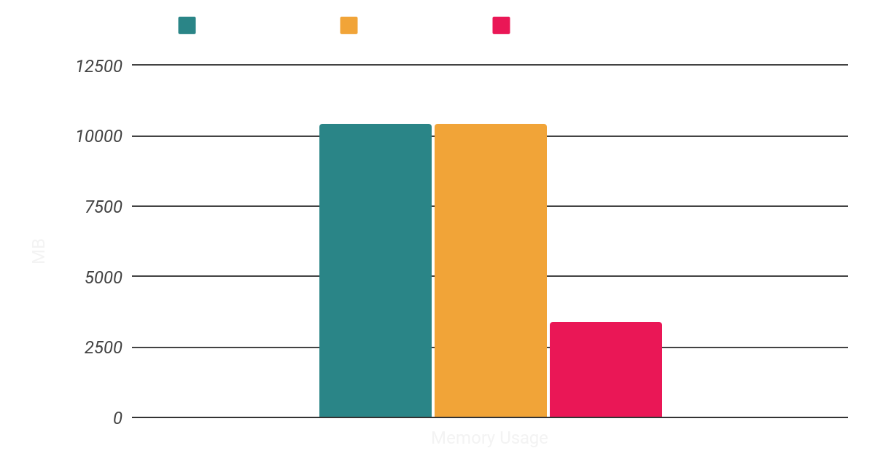
1-2. Memory usage of pd.DataFrame object
I. Memory Optimization

Slide 99
1-3. Results of specifying data types
I. Memory Optimization
Pandas 2.0.3 [pyarrow] shows significant improvement on overall settings
Setting | Metric | Pandas 0.24.2 | Pandas 2.0.3 | Pandas 2.0.3 [pyarrow] | Speed-up
Default | time | 33.4 s | 28.2 s | 2.4 s | 13.9x
 | increment memory | 8,847 Mb | 8,847 Mb | 6,741 Mb | 1.3x
 | memory usage | 10,443 Mb | 10,443 Mb | 3,393 Mb | 3.1x
Codebook | time | 15.4 s | 23.6 s | 12.2 s | 1.2x
 | increment memory | 3,668 Mb | 2,796 Mb | 755 Mb | 4.9x
 | memory usage | 10,443 Mb | 8,006 Mb | 2,847 Mb | 3.7x
Dtypes | time | 34.7 s | 26 s | 5.5 s | 6.3x
 | increment memory | 821 Mb | 2,263 Mb | 4,347 Mb | 0.2x
 | memory usage | 3,393 Mb | 1,063 Mb | 1,092 Mb | 3.1x

Slide 100
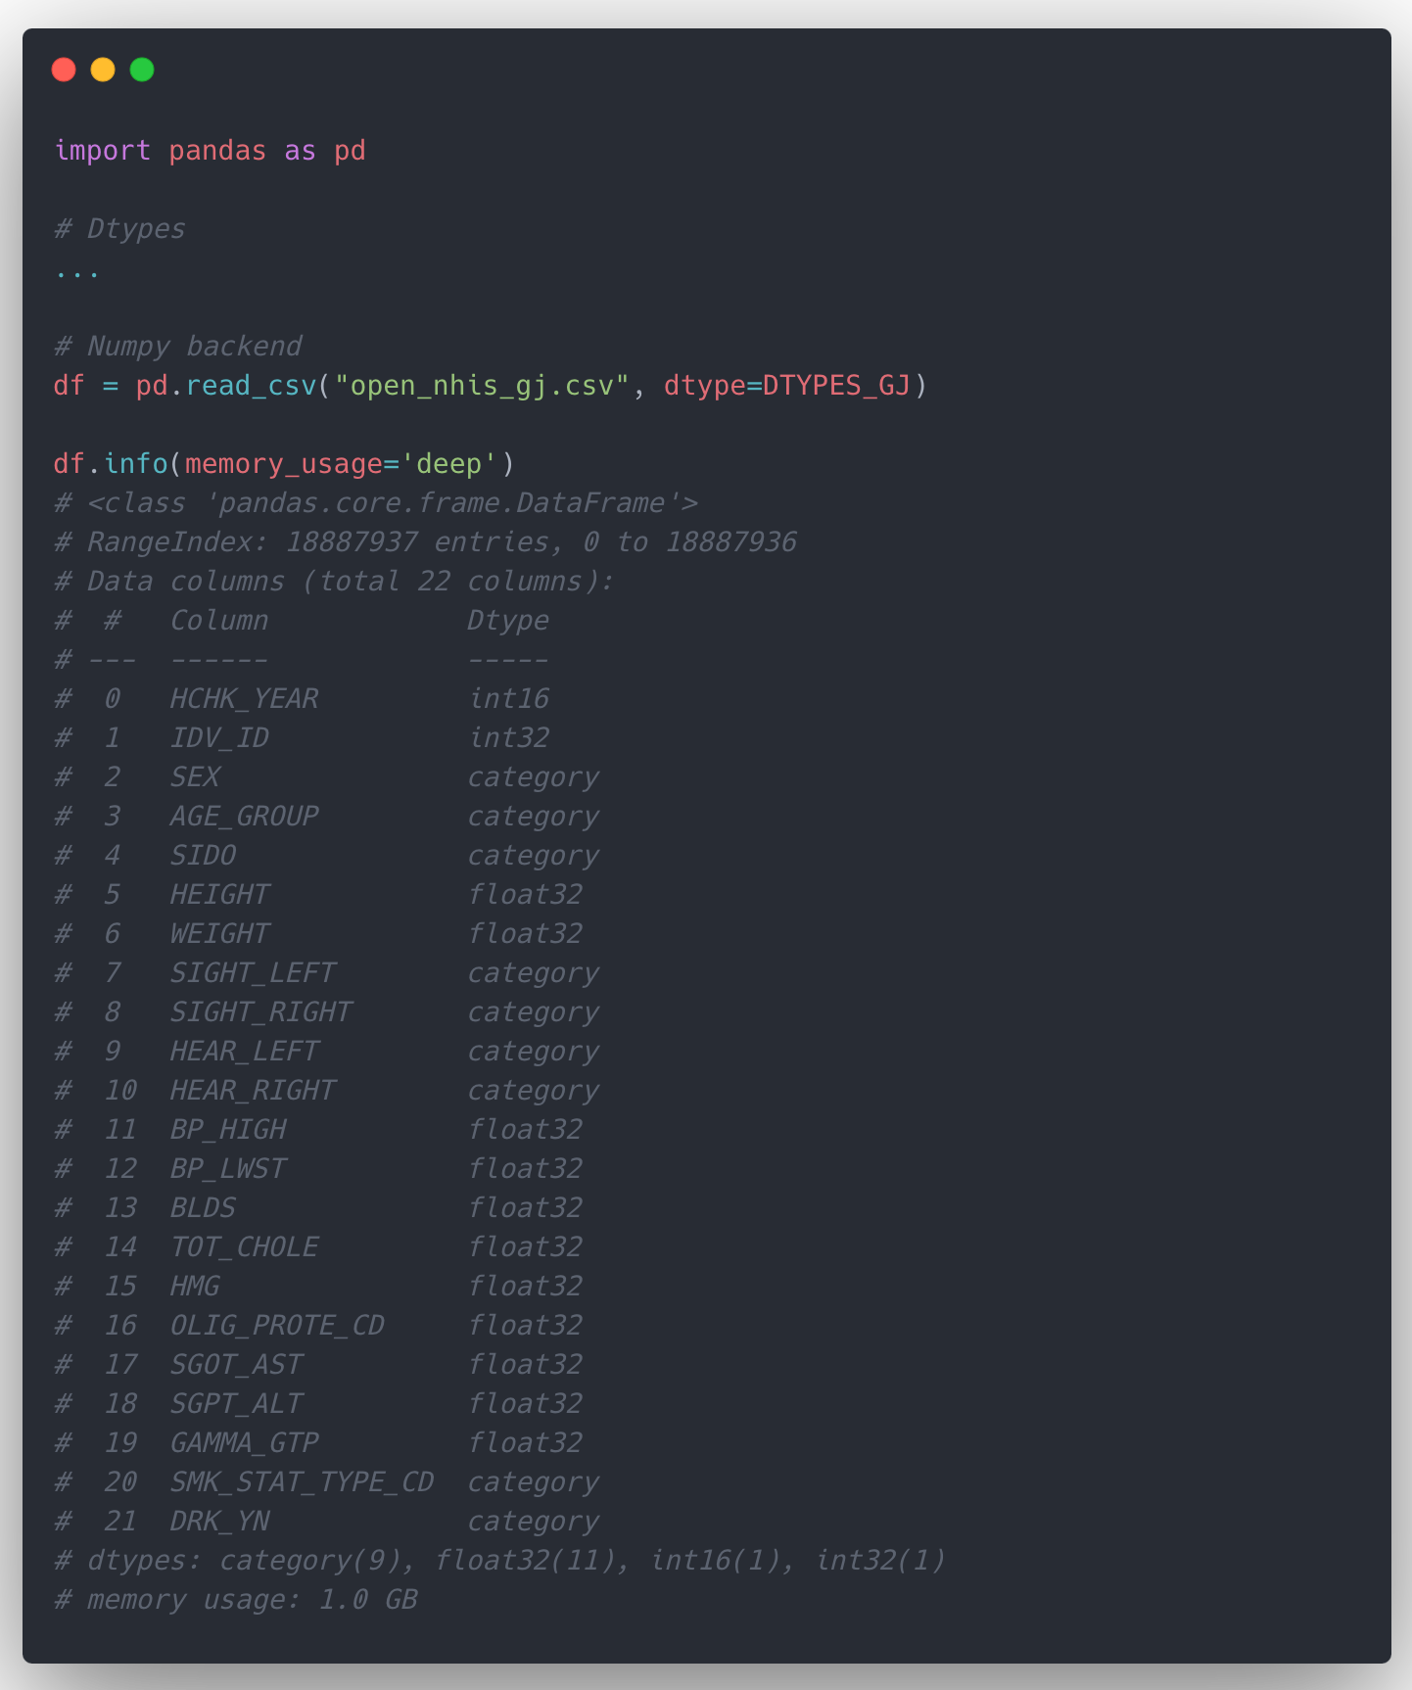
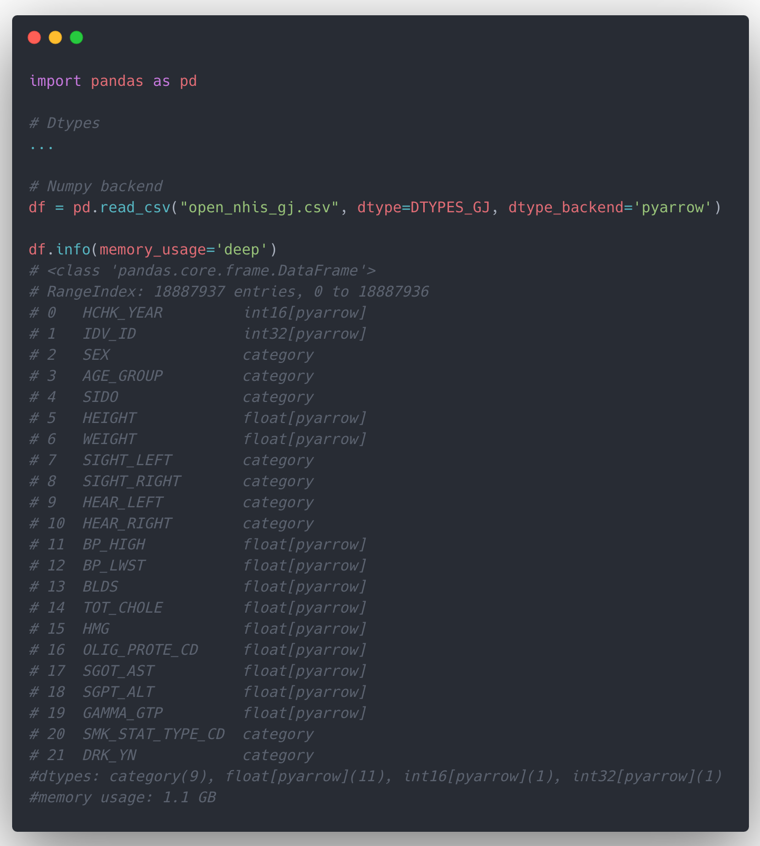
[Appendix] New feature: dtype_backend
I. Memory Optimization
NumPy
PyArrow

Slide 101
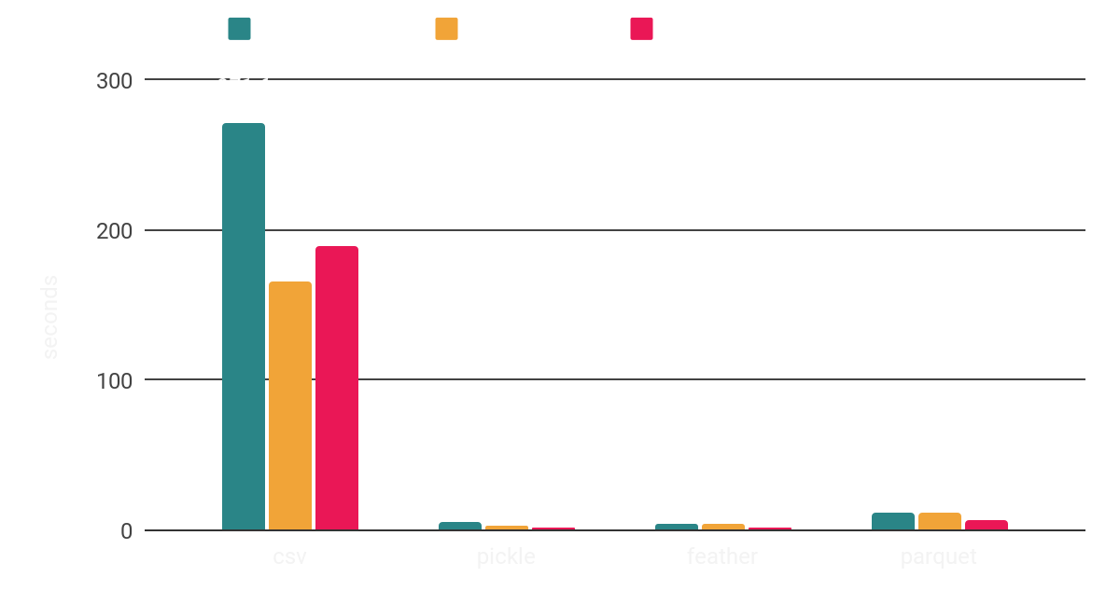
2-1. Time to write a file
I. Memory Optimization
csv <<<< parquet < pickle, feather

Slide 102
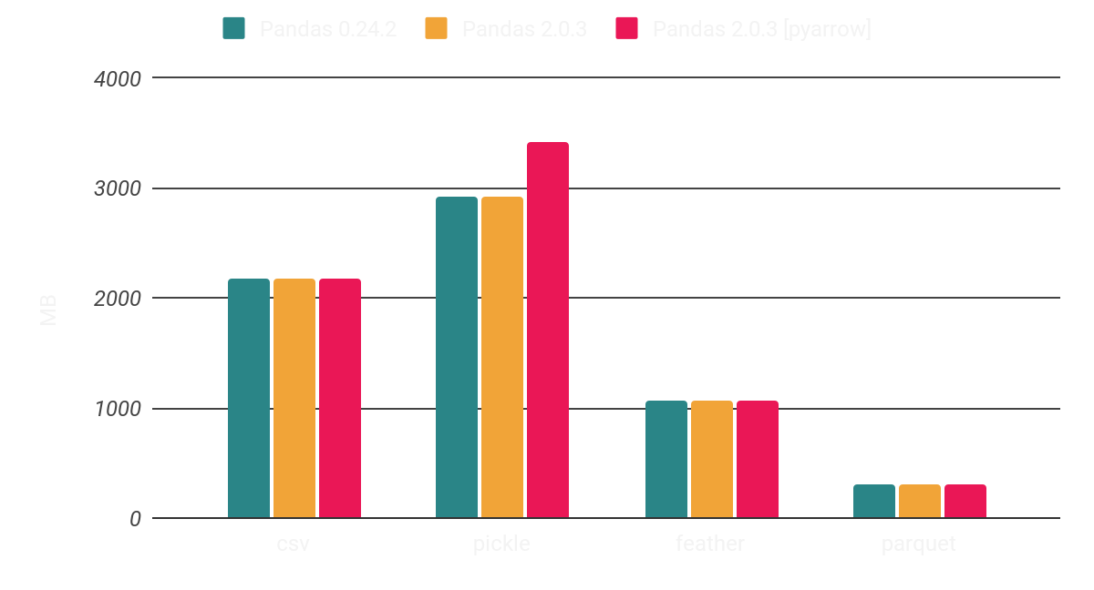
2-2. Disk size of the saved file
I. Memory Optimization
pickle < csv << feather << parquet

Slide 103
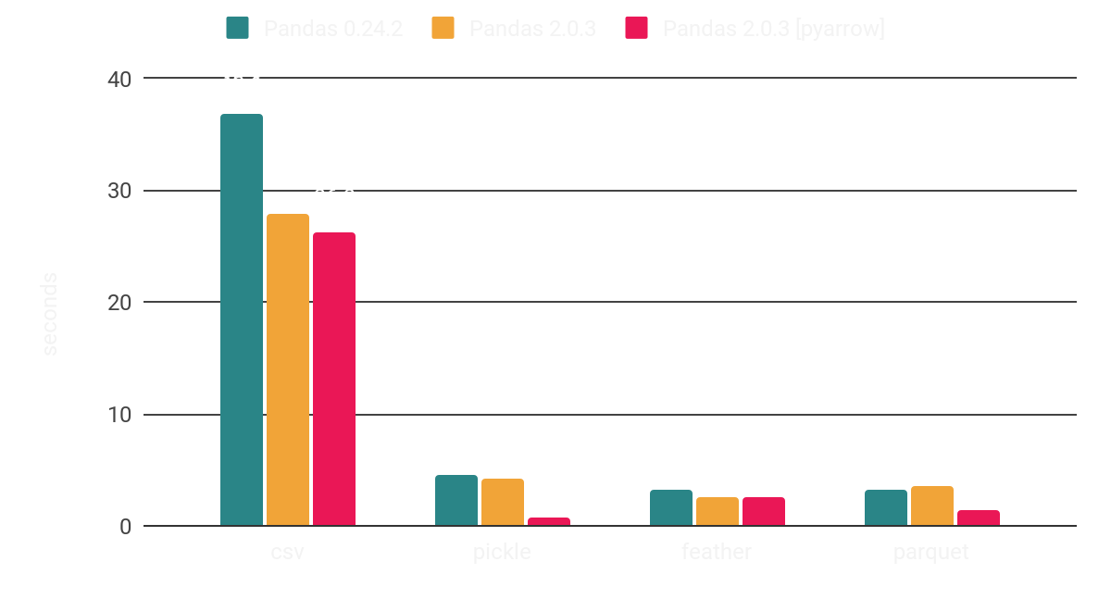
2-3. Time to read a file
I. Memory Optimization
csv <<<< pickle < feather, parquet

Slide 104
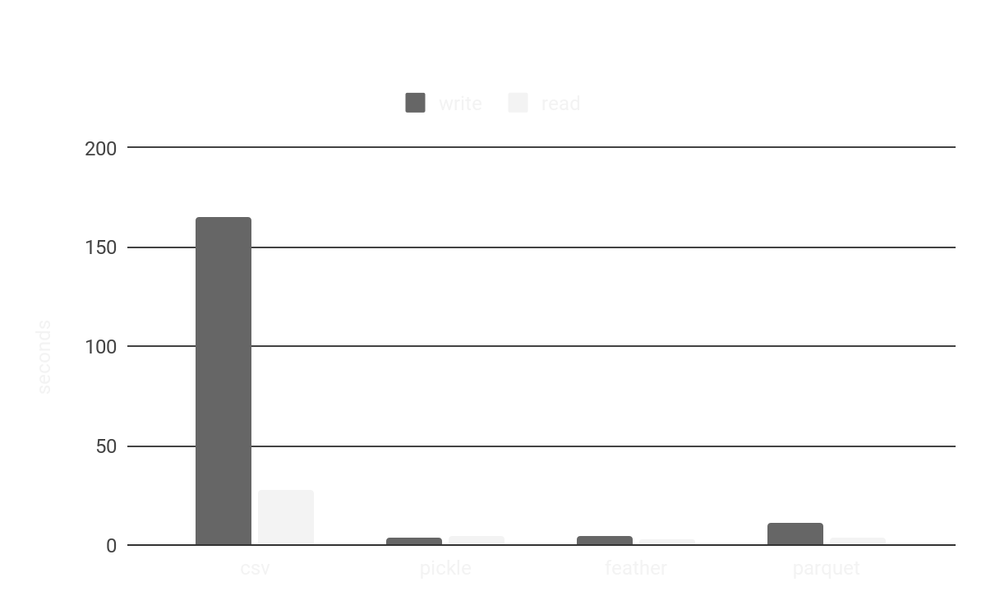
[Appendix]
I. Memory Optimization

Slide 105
II. Performance Enhancement
II. Performance Enhancement
Purpose
: to enhance performance on manipulating and analyzing data
Testing
Methods to score health check rows (19M rows)
Iteration: pd.DataFrame.iterrows(), pd.DataFrame.apply()
Vectorization: pd.Series, np.array, pa.array
Comparison of operations to get same result (19M rows)
sort_values().head() VS. nlargest()
Comparison of operations to extract subset satisfied specific conditions (185M rows)
Conditional matching 940 people’s medical history from 185M rows

Slide 106
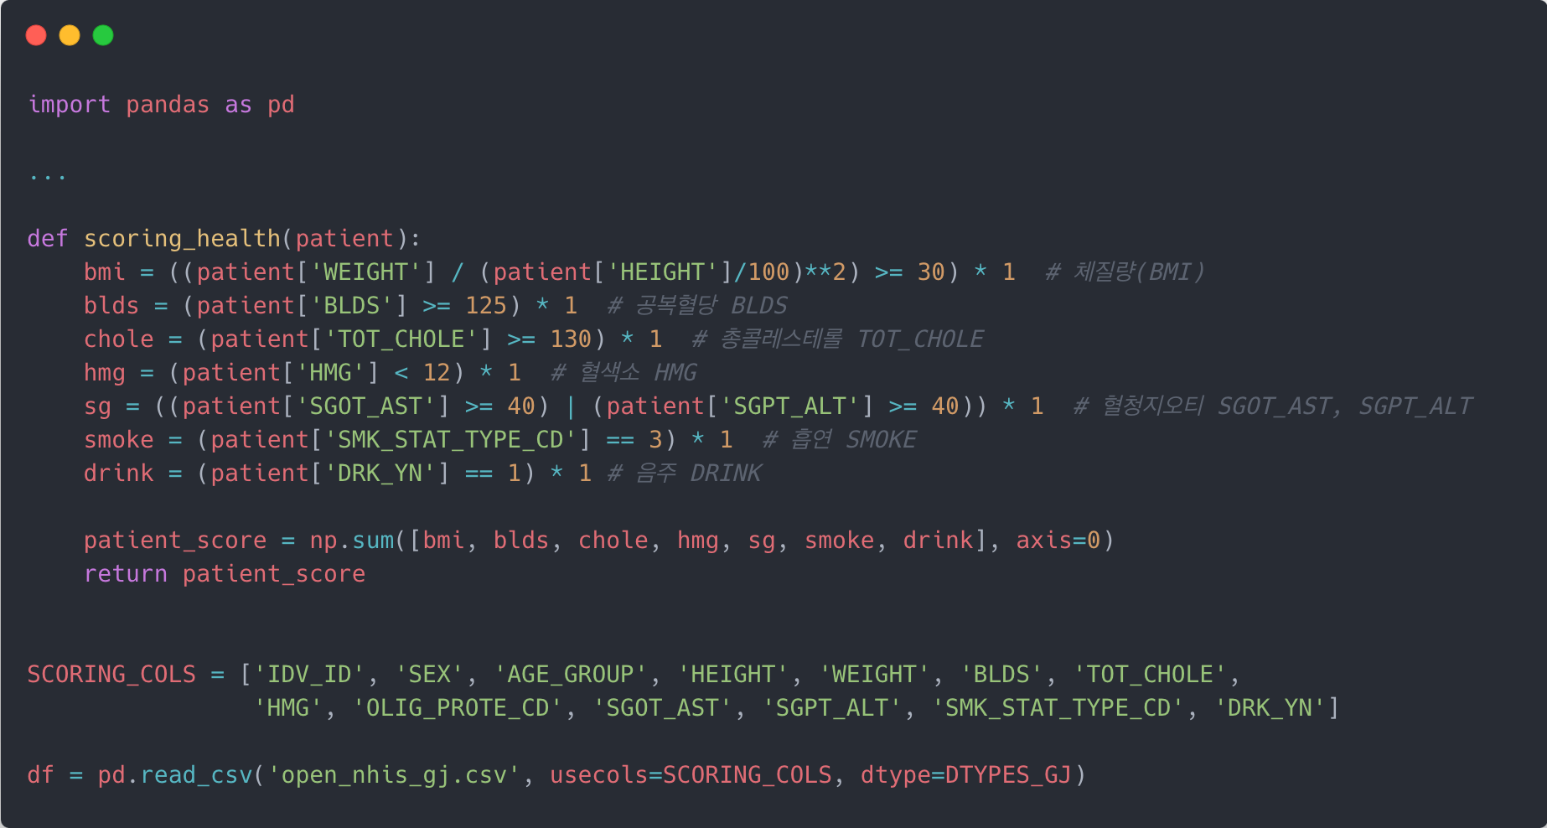
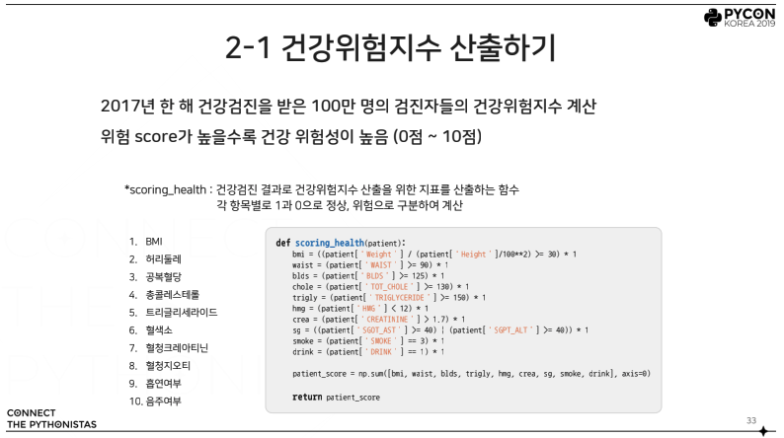
[Appendix] Scoring Health Check Data
II. Performance Enhancement
To test performance of Arithmetic operation
Focused on the performance of time and increment memory

Slide 107
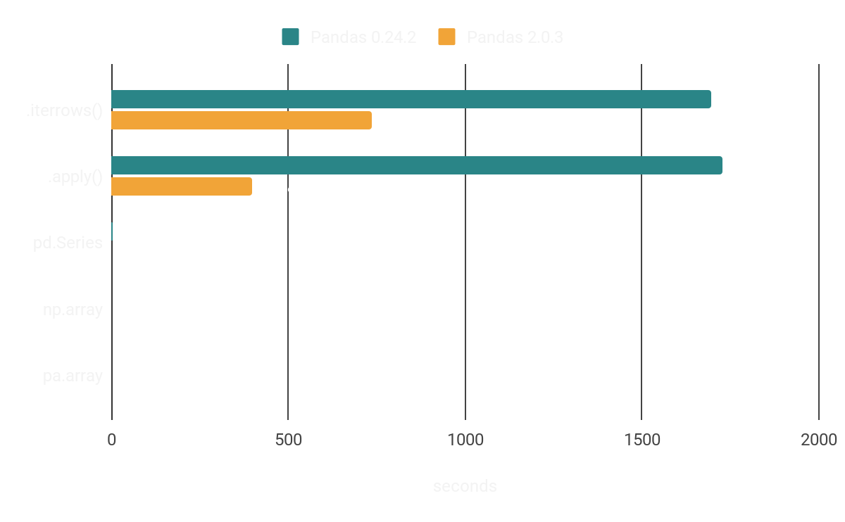
1-1. Time to score health check
II. Performance Enhancement

Slide 108
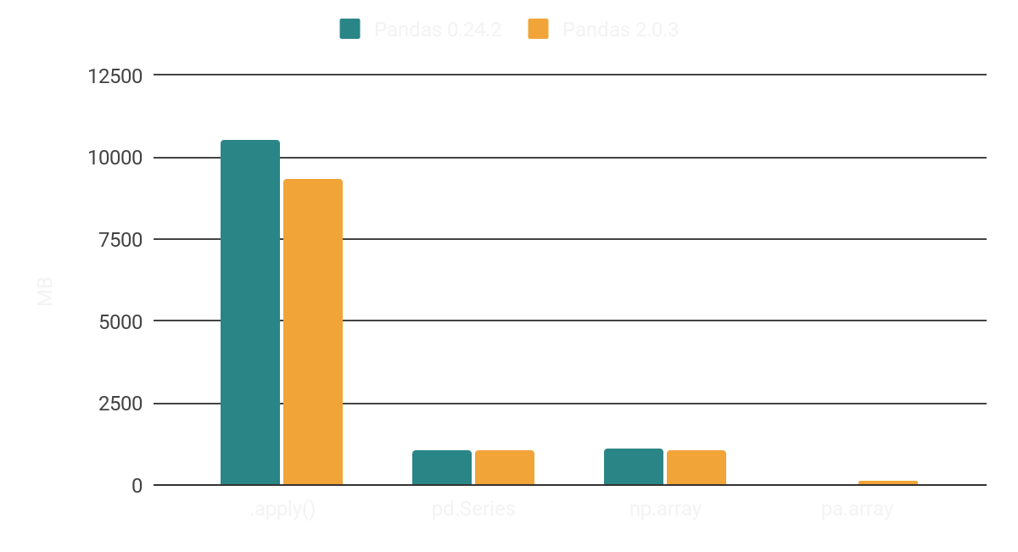
1-2. Increment Memory while scoring
II. Performance Enhancement

Slide 109
1-3. Result of Performance by methods
II. Performance Enhancement
Vectorization is still much faster than Iteration
Methods | Example Code | Time
Iteration with pd.DataFrame.iterrows() | scores = [] for _, row in df.iterrows(): scores.append(scoring_health(row)) | 12 min 18 s
Iteration with pd.DataFrame.apply() | scores = df.apply(scoring_health, axis=1) | 6 min 38 s
Vectorization with pd.Series | scores = scoring_health(df) | 1.54 s
Vectorization with np.array | scores = scoring_health_np(df) | 1.50 s
Vectorization with pa.array | scores = scoring_health_pa(df) | 1.29 s
570x Speed up

Slide 110
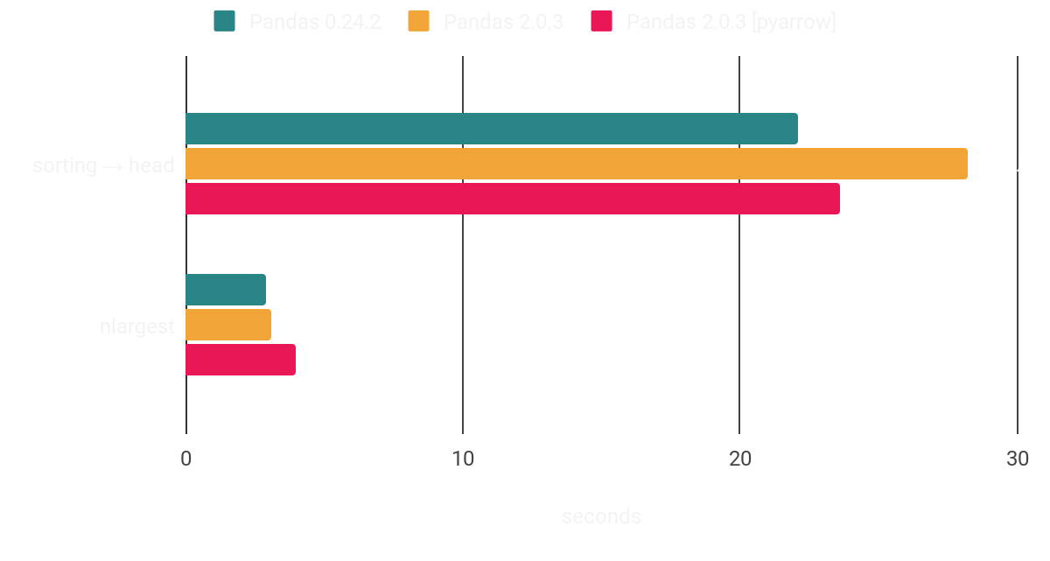
2-1. Time to get same result
II. Performance Enhancement
sort_values().head() <<< nlargest()

Slide 111
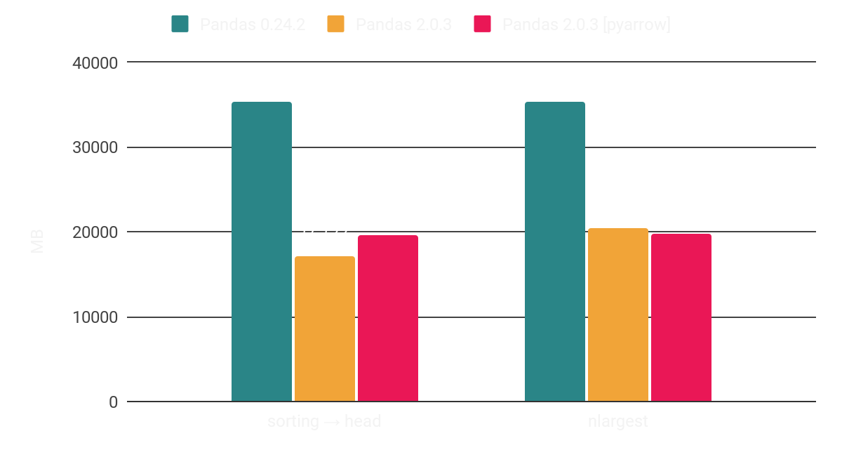
2-2. Increment Memory while getting result
II. Performance Enhancement
Pandas 2.0.3 is memory-efficient than the previous one

Slide 112
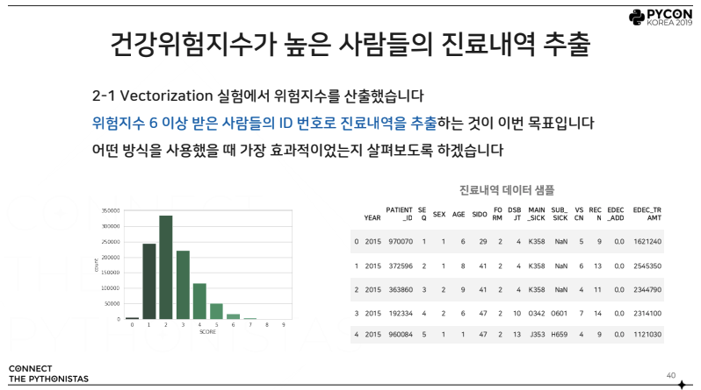
[Appendix] Extracting Subset Specific Conditions
II. Performance Enhancement
Compare methods to extract same subset data which satisfied specific conditions
Methods to extract same subset
List Comprehension
pd.DataFrame.apply
pd.DataFrame.isin
pd.DataFrame.query
pd.DataFrame.merge
np.isin
pa.compute.is_in

Slide 113
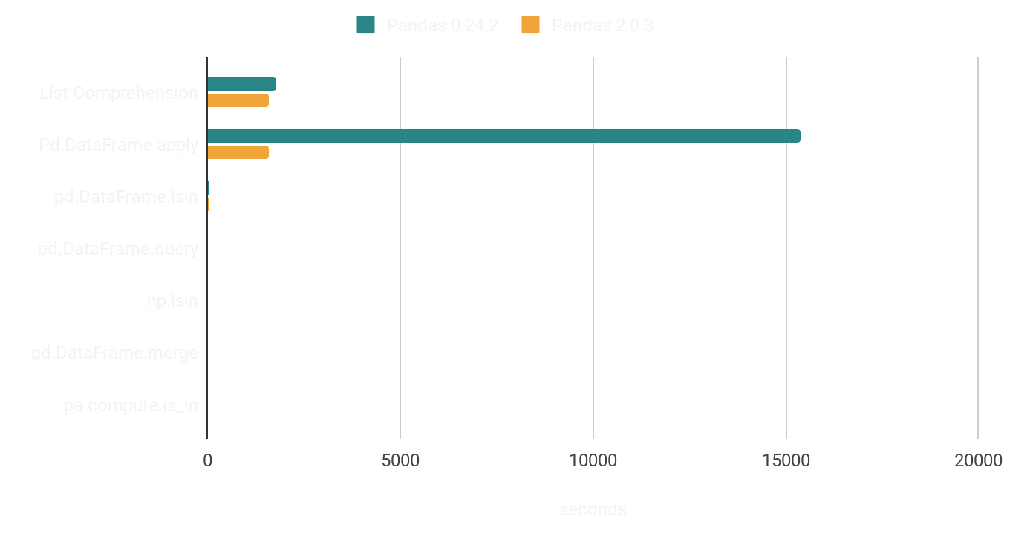
3-1. Extracting same subset of Medical History
II. Performance Enhancement
Extracting subset of 940 people’s medical history from 185M rows

Slide 114
3-2. Extracting same subset
II. Performance Enhancement
Methods | Example Code | Pandas 0.24.2 | Pandas 2.0.3
List Comprehension | subset = df[[x in PEOPLE for x in df[“IDV_ID”]]] | 30min 1s | 26min 29s
pd.DataFrame.apply | subset = df[df[“IDV_ID”].apply(lambda x: x in PEOPLE)] | 136min 33s | 26min 27s
pd.DataFrame.isin | subset = df[df.isin({“IDV_ID”: PEOPLE})] | 49s | 37.9s
pd.DataFrame.query | subset = df.query(“IDV_ID in @PEOPLE”) | 24.5s | 6.0s
pd.DataFrame.merge | subset = df.merge(pd.Series(PEOPLE, name=”IDV_ID”), how=’inner’, on=”IDV_ID”) | 7.86s | 12.9s
np.isin | subset = df[np.isin(df[“IDV_ID”].values, PEOPLE)] | 21.2s | 1.9s
pa.compute.is_in | subset = df[pa.compute.is_in(pa.array(df[“IDV_ID”]), pa.array(PEOPLE)).to_pandas()] | - | 2.9s
836x Speed up

Slide 115
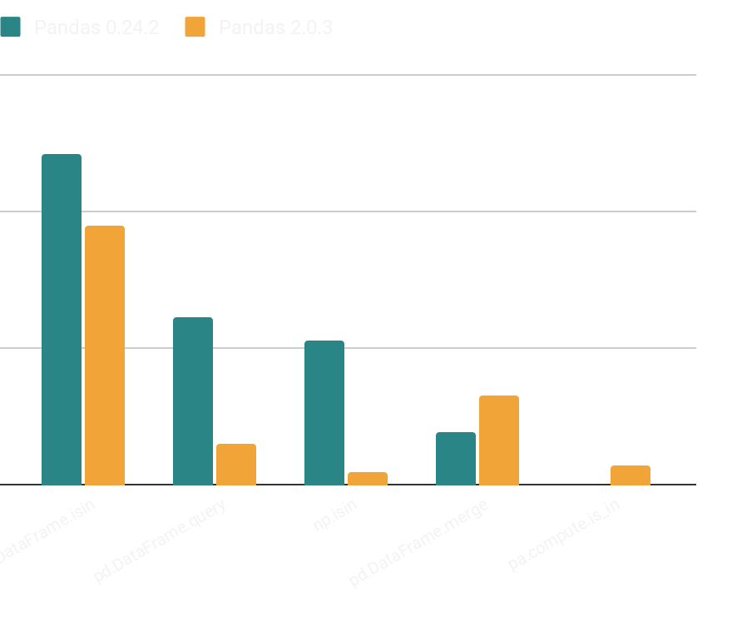
3-3. Extracting same subset
II. Performance Enhancement
pd.DataFrame.merge was the fastest method in Pandas 0.24.2
Overall improvement on all methods in Pandas 2.0.3

Slide 116
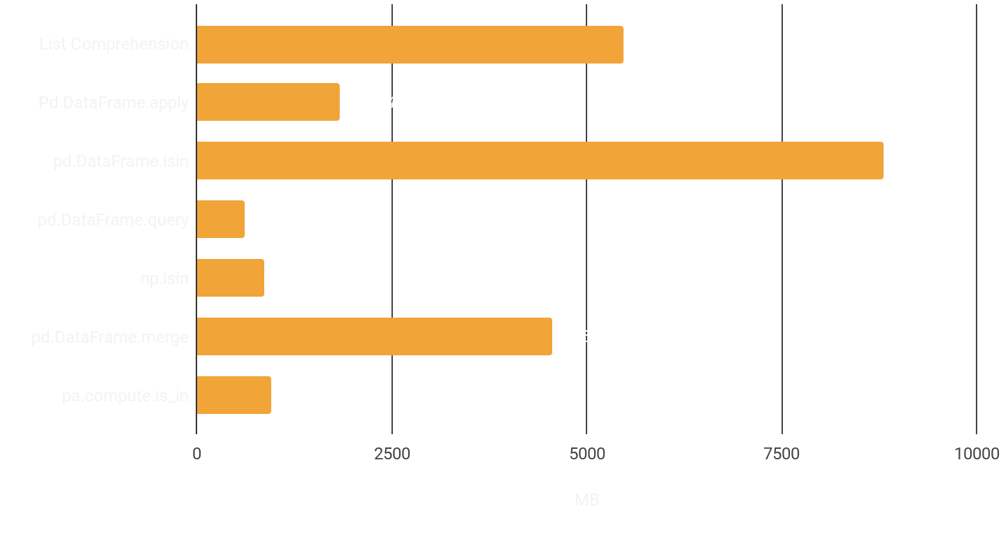
3-4. Increment Memory while extraction
II. Performance Enhancement
Pandas’ built-in operations became memory-stable in version 2.0.3

Slide 117
III. Method Chaining
III. Method Chaining
A pattern that allows methods to be chained by returning an object
일반적인 방법
Method Chaining
jack_jill = JackAndJill()
on_hill = went_up(jack_jill, 'hill')
with_water = fetch(on_hill, 'water')
fallen = fell_down(with_water, jack')
broken = broke(fallen, 'jack')
after = tmple_after(broken, 'jill')
jack_jill = JackAndJill()
after = (jack_jill
.went_up("hill")
.fetch("water")
.fell_down("jack")
.broke("crown")
.tumble_after("jill")
)

Slide 118
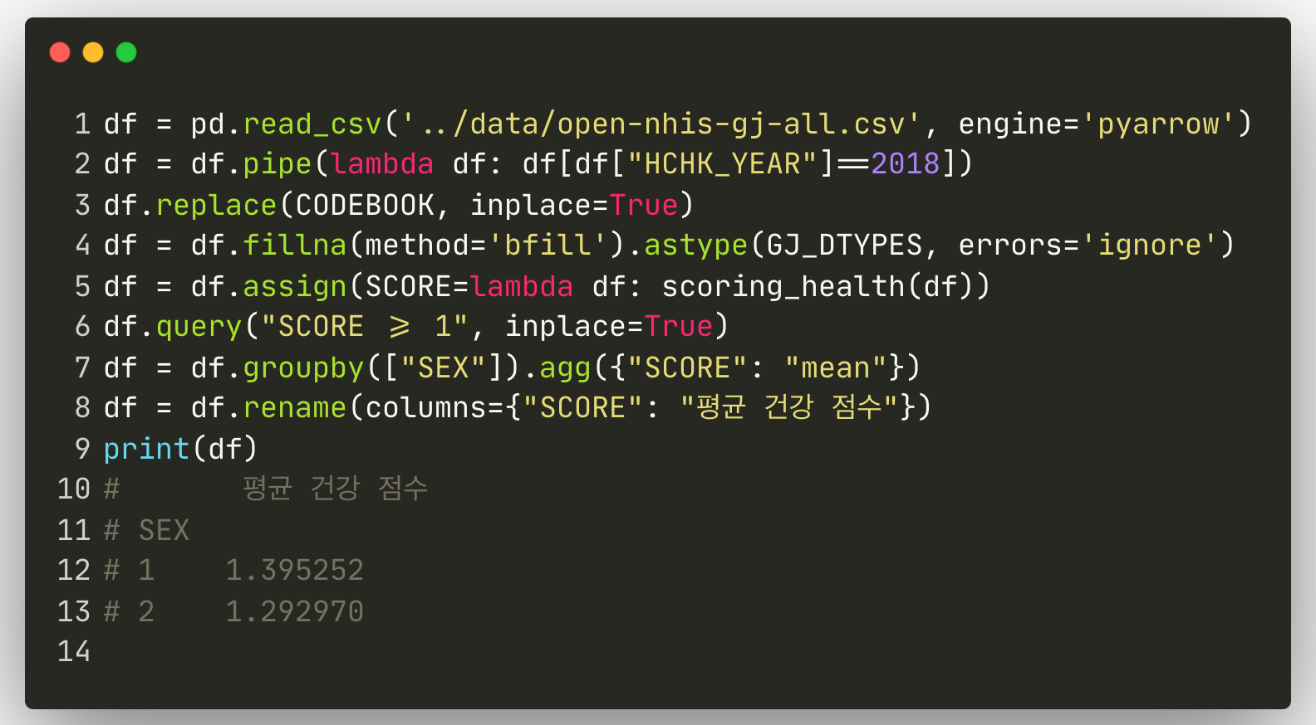
Sample Code to Return Mean Scores by Groups
III. Method Chaining

Slide 119
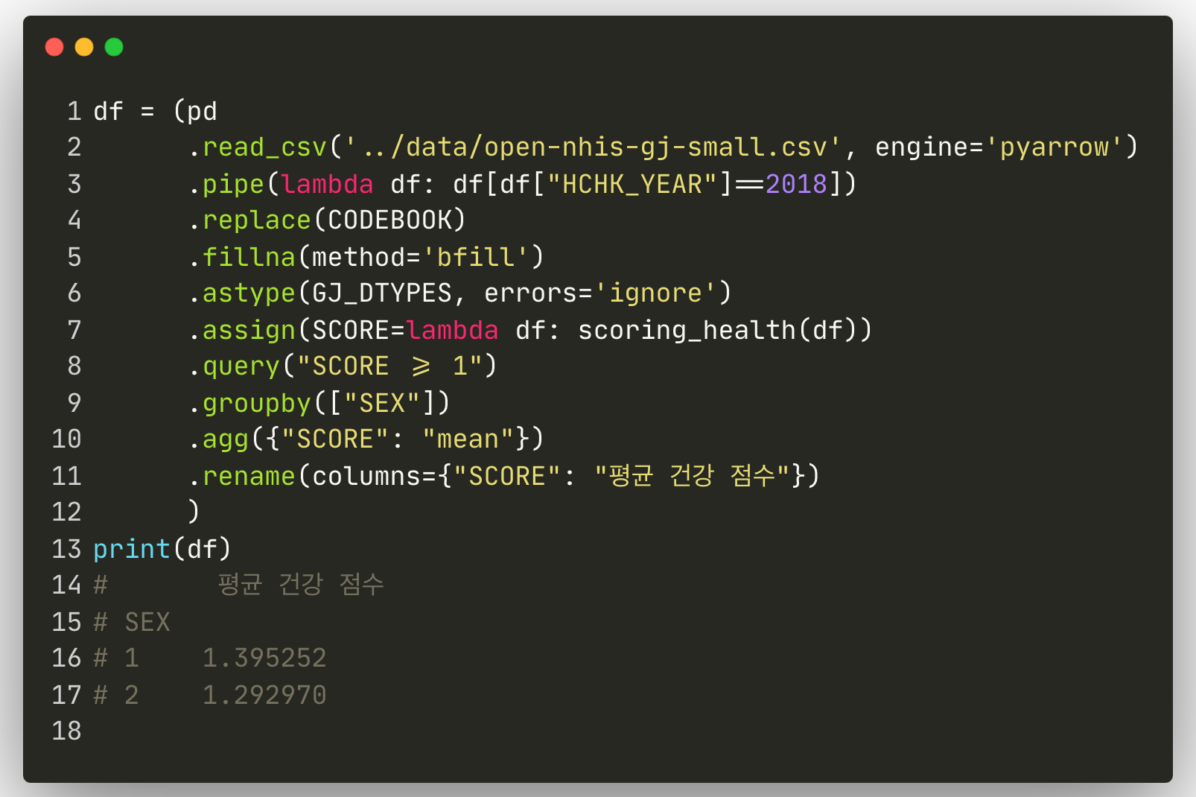
Applying Method Chaining
III. Method Chaining

Slide 120
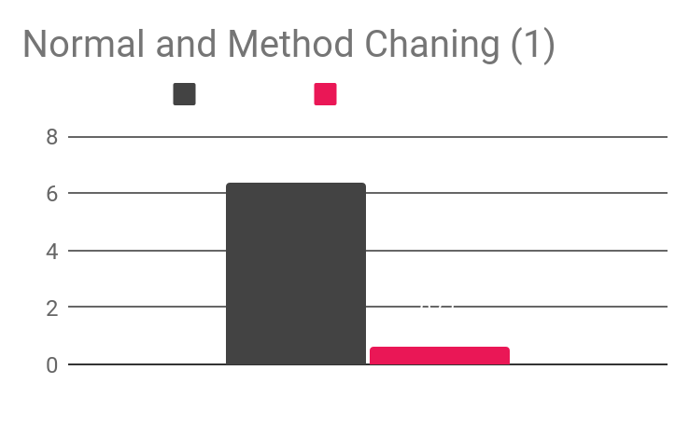
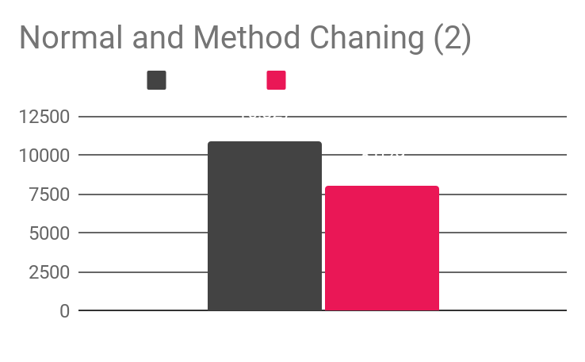
Chained Assignment is More Faster & Efficient
III. Method Chaining
After applying method chaining,
Time to operate all methods is 9x faster
Peak Memory & Increment memory are significantly lower and stable

Slide 121
Review - Reproduction of 2019 Strategies
III. Method Chaining
Most strategies are still feasible in Pandas 2
More performance-enhanced to overall Pandas built-in methods
With CoW & Arrow Integration, the Method Chaining is getting memory-stable and easily debuggable
Significant performance improvements with Small API changes

Slide 122

If Data Size Larger than Local Hard Disk?

Slide 123
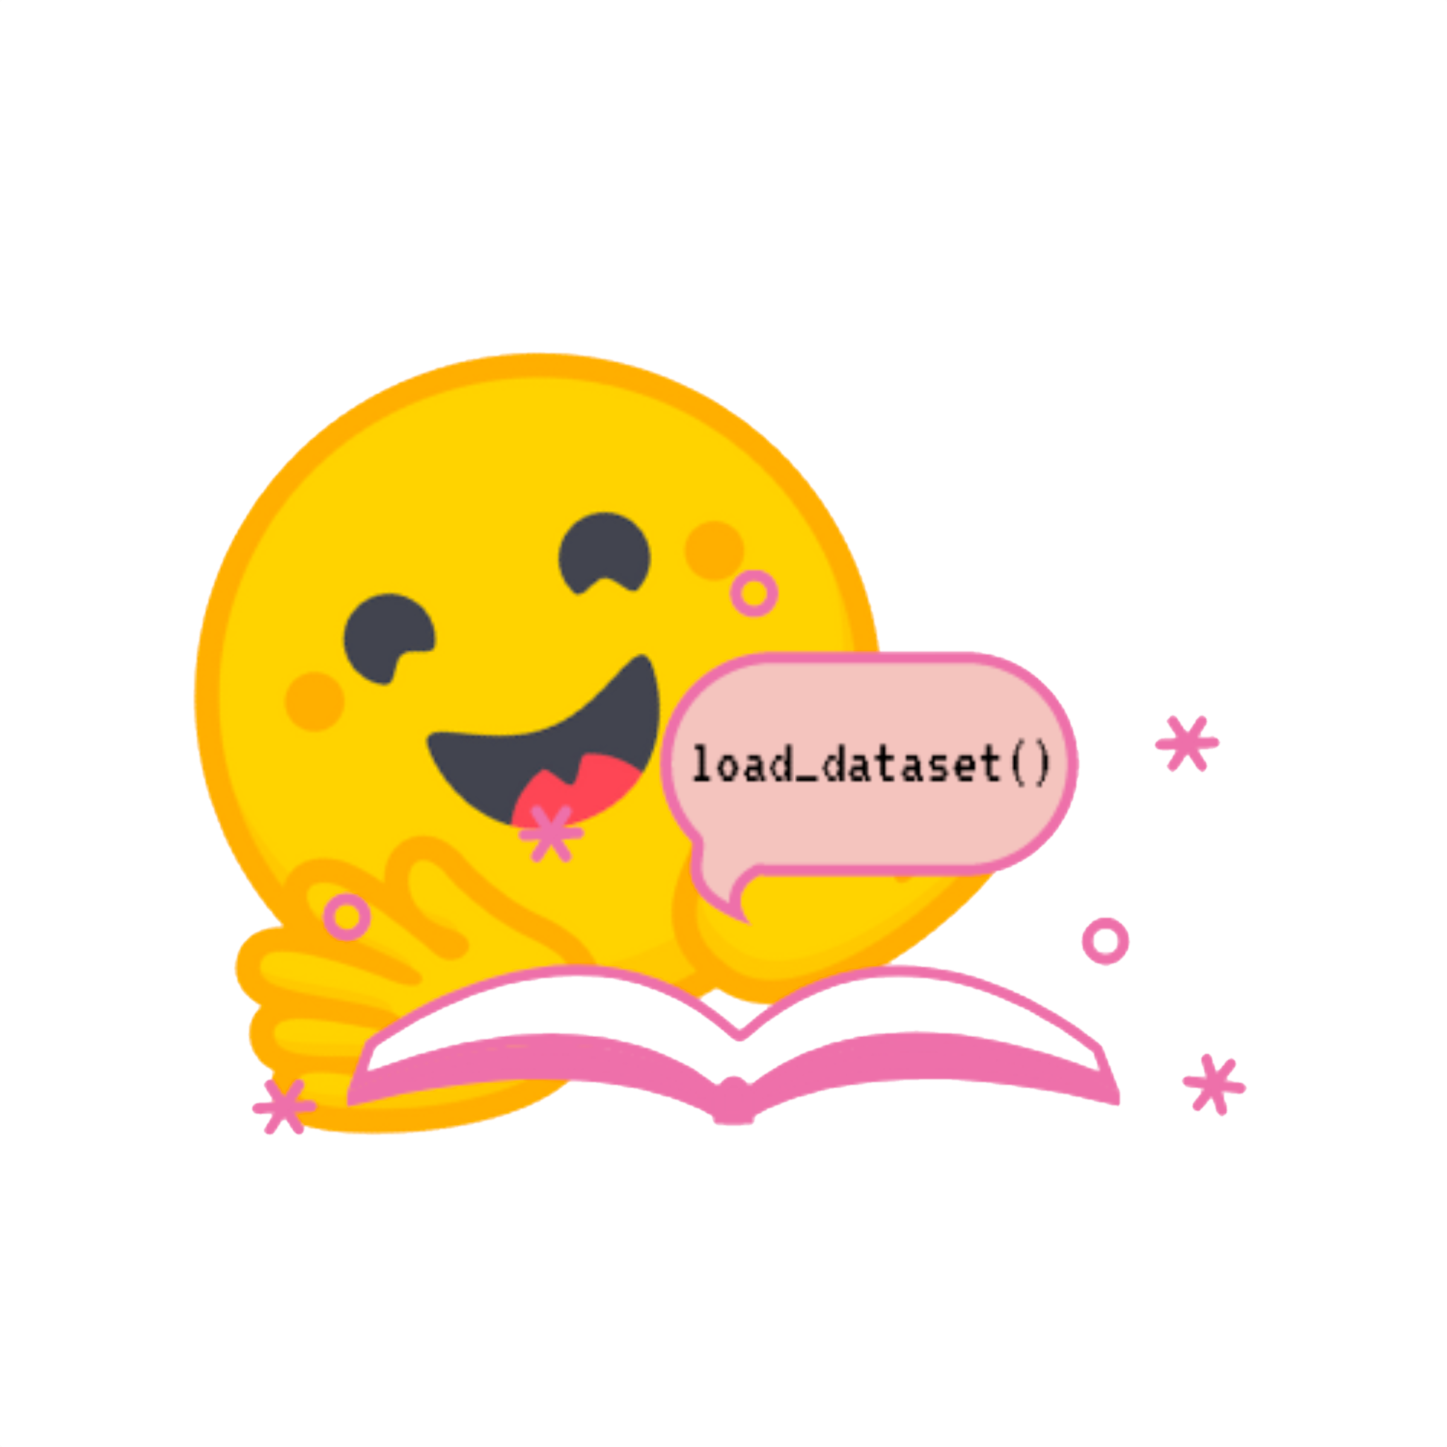
Hugging Face Datasets
Library for easily accessing and sharing datasets
Audio, Computer Vision and Natural Language Processing tasks
also supports Tabular dataset
Load a dataset in a single line of code
Backed by Apache Arrow format, process large datasets with zero-copy reads without memory constraints for optimal speed and efficiency
With the Hugging Face Hub, allowing easily load & share a dataset
Sources: https://huggingface.co/docs/datasets/index

Slide 124
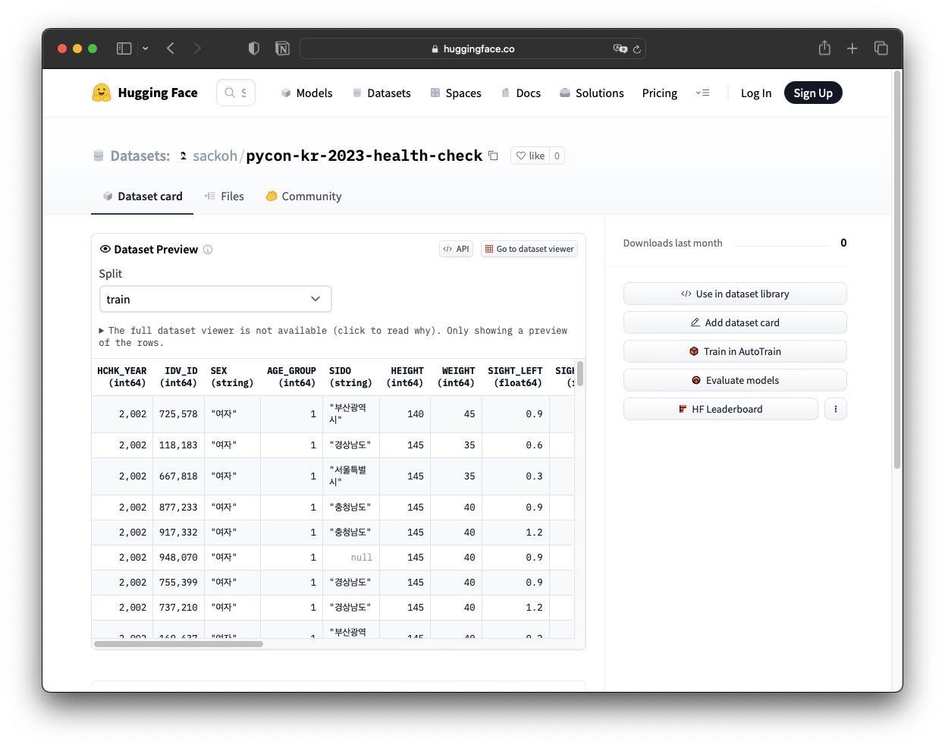
Health Check Data on the Hugging Face Hub
https://huggingface.co/datasets/sackoh/pycon-kr-2023-health-check

Slide 125
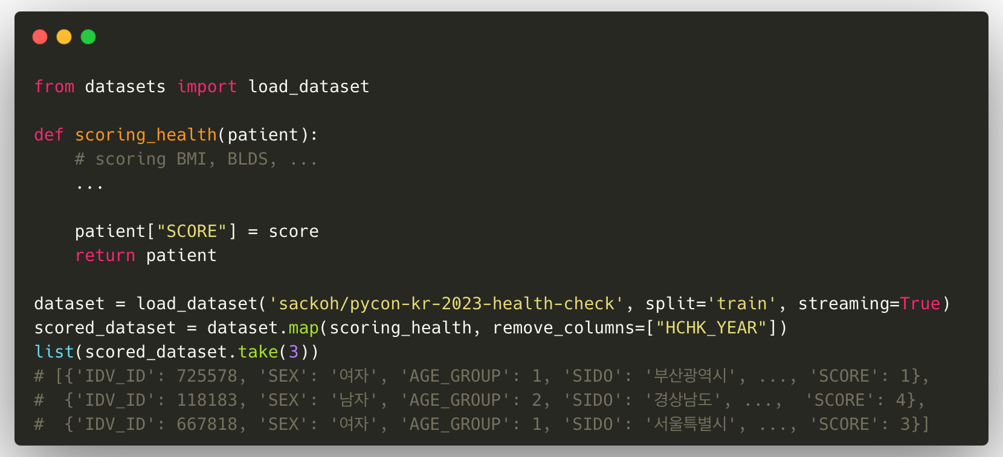
Stream & Process Partial Data

Slide 126


Source codes Available at https://github.com/sackoh/pycon-korea-2023-efficient-pandas2
Testing Dataset Available at https://huggingface.co/datasets/sackoh/pycon-kr-2023-health-check

Slide 127

Next Match Up: Pandas vs. Polars

Slide 128
Thank you
for your time and consideration

